Slide 1
CHAPTER 7 SORTING
All the programs in this file are selected from
Ellis Horowitz, Sartaj Sahni, and Susan Anderson-Freed
“Fundamentals of Data Structures in C”,

Slide 2
Collection of Records
We use list to mean a collection of records
The fields used to distinguish among the records are known as keys
Telephone directory
Each record has three fields: name, address, and phone number
The key is usually the person’s name
The list can be stored in position 1 through n of an array

Slide 3
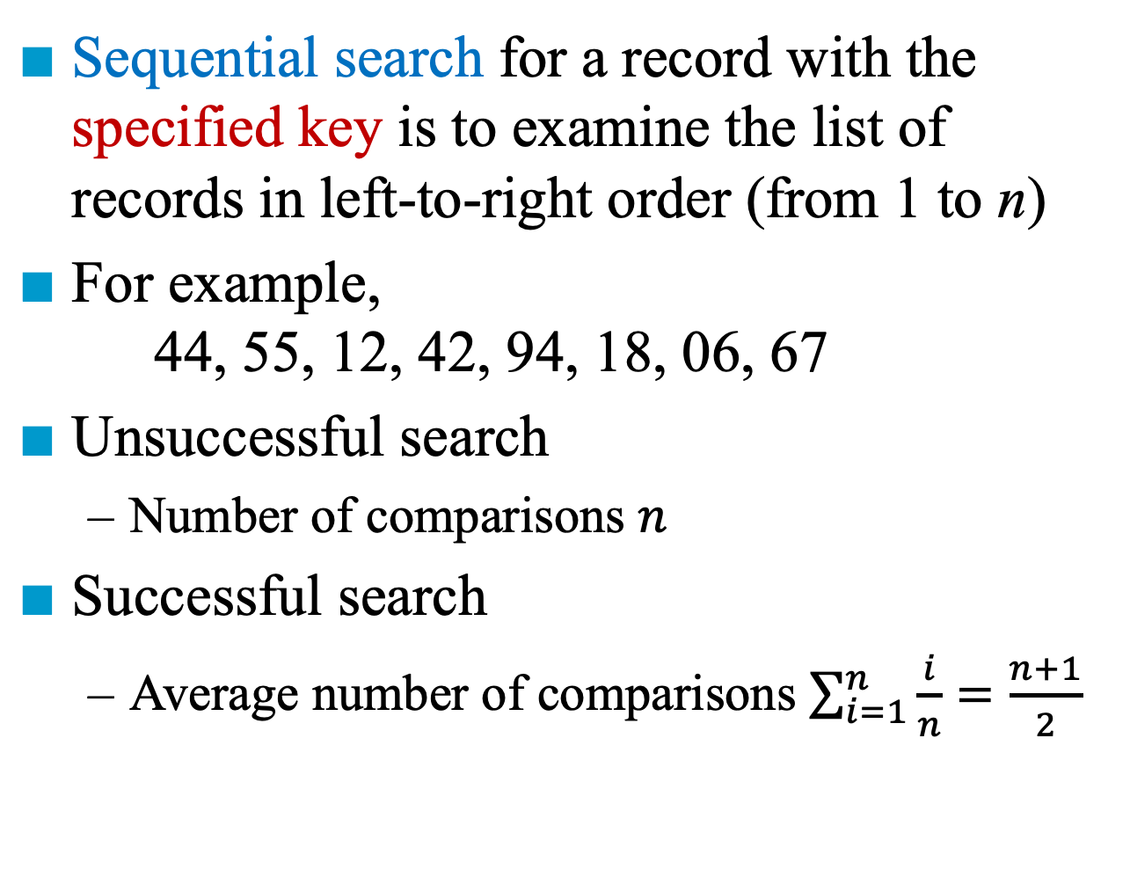
Search
Sequential search for a record with the specified key is to examine the list of records in left-to-right order (from 1 to n)
For example, 44, 55, 12, 42, 94, 18, 06, 67
Unsuccessful search
Number of comparisons $n$
Successful search
Average number of comparisons $\sum_{i=1}^{n}{\frac{i}{n}}=\frac{n+1}{2}$

Slide 4
#define MAX_SIZE 1000 /* maximum size of list plus one */ typedef struct { int key; /* other fields */ } element; element list[MAX_SIZE];
Representation

Slide 5
int seqSearch(element a[], int k, int n ) { /*search a[1:n]; return the least I such that a[i].key = k; return 0, if k is not in the array */ int i; for (i = 1; i <= n && a[i].key != k; i++) ; if (i > n) return 0; return i; }
Sequential Search
*Program 7.1: Sequential search (p.334)

Slide 6
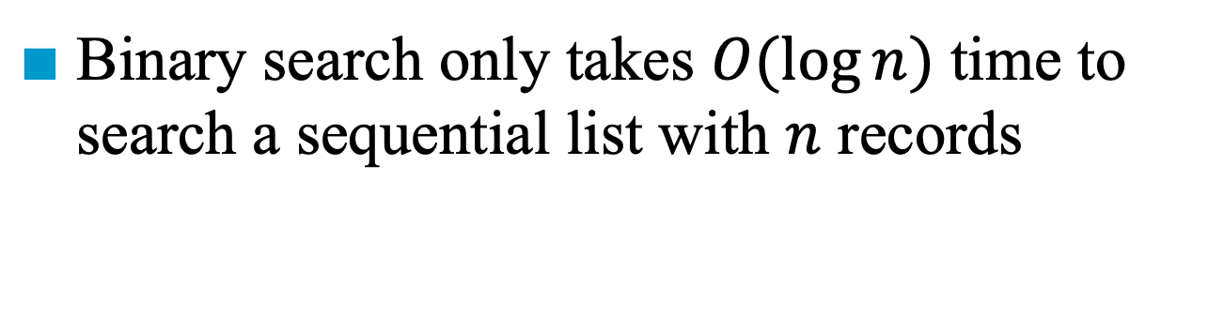
Search
Binary search only takes $O(log⁡n)$ time to search a sequential list with $n$ records
Sorted list: 4, 15, 17, 26, 30, 46, 48, 56, 58, 82, 90, 95
[6]
46
[3]
[9]
17
58
[1]
[4]
[7]
[11]
4
26
48
90
[2]
[5]
[8]
[10]
[12]
15
30
56
82
95

Slide 7
int binsearch(element list[], int k, int n) { int left = 1, right = n, middle; while (left <= right) { middle = (left + right)/2; switch (COMPARE(list[middle].key, k)) { case -1: left = middle + 1; break; case 0: return middle; case 1: right = middle - 1; } } return 0; }
Binary Search
O(log n)
*Program 1.7: Search in an ordered list (p.13)

Slide 8
List Verification
Compare two lists to verify that they are identical or identify the discrepancies
Example 1:
UnsortedList₁: 5, 3, 11, 9, 1, 7
UnsortedList₂: 7, 5, 11, 2, 3
Example 2:
OrderedList₁: 1, 3, 5, 7, 9, 11
OrderedList₂: 2, 3, 5, 7, 11

Slide 9
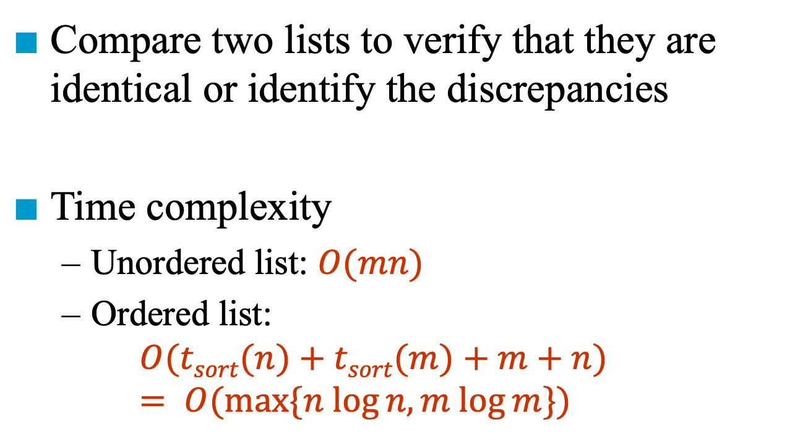
List Verification
Compare two lists to verify that they are identical or identify the discrepancies
Time complexity
Unordered list: $O(mn)$
Ordered list: $O(tsort(n)+tsort(m)+m+n)$ $= O(max⁡\{n log⁡n, m log⁡m\})$

Slide 10
void verify1(element list1[], element list2[], int n, int m) { /* compare two unordered lists list1[1:n] and list2[1:m] */ int i, j, marked[MAX_SIZE]; for(i = 0; i < m; i++) marked[i] = FALSE; for (i = 0; i < n; i++) if ((j = seqSearch(list2, list1[i].key, m)) == 0) printf(“%d is not in list 2\n “, list1[i].key); else /* check each of the other fields from list1[i] and list2[j], and print out any discrepancies */ marked[j] = TRUE;
Verification for Unordered Lists
(a) all records found in list1 but not in list2
(b) all records found in list2 but not in list1
(c) all records that are in list1 and list2 with
the same key but have different values
for different fields.

Slide 11
for ( i=0; i<m; i++) if (!marked[i]) printf(“%d is not in list1\n”, list2[i]key); }
*Program 7.2: Verifying two sorted lists using a sequential search (p.336)

Slide 12
void verify2(element list1[], element list2 [ ], int n, int m) /* Same task as verify1, but list1 and list2 are sorted */ { int i, j; sort(list1, n); sort(list2, m); i = j = 0; while (i < n && j < m) if (list1[i].key < list2[j].key) { printf (“%d is not in list 2 \n”, list1[i].key); i++; } else if (list1[i].key == list2[j].key) { /* compare list1[i] and list2[j] on each of the other field and report any discrepancies */ i++; j++; }
Verification for ordered Lists

Slide 13
else { printf(“%d is not in list 1\n”, list2[j].key); j++; } for(; i < n; i++) printf (“%d is not in list 2\n”, list1[i].key); for(; j < m; j++) printf(“%d is not in list 1\n”, list2[j].key); }
*Program 7.3: Fast verification of two sorted lists (p.337)

Slide 14
Applications of Sorting
We have seen the uses of sorting
An aid in searching
Comparison of two lists
Sorting is used in many applications
Estimated 25% of all computing time is spent on sorting
No one sorting method is the best for all initial orderings of the list being sorted

Slide 16
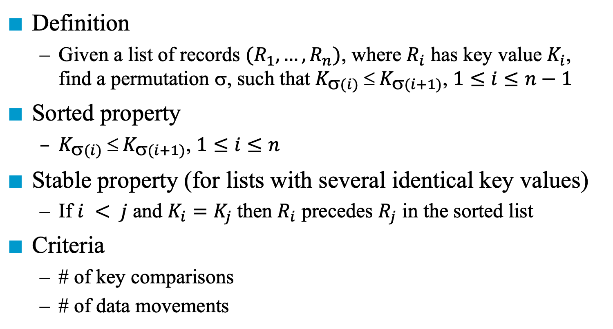
Sorting Problem
Definition
Given a list of records $(R_{1}, …, R_{n})$, where $R_{i}$ has key value $K_{i}$, find a permutation $$, such that $K_{(i)}  K_{(i+1)}$, $1≤i≤n−1$
Sorted property
$K_{(i)}  K_{(i+1)}$, $1≤i≤n$
Stable property (for lists with several identical key values)
If $i < j$ and $K_{i}=K_{j}$then $R_{i}$ precedes $R_{j}$ in the sorted list
Criteria
# of key comparisons
# of data movements

Slide 17
Categories of Sorting Methods
Internal Methods: Methods to be used when the list to be sorted is small enough so that the entire sort list can be carried out in the main memory
Insertion sort, quick sort, merge sort, heap sort, and radix sort
External method: Methods to be used on larger lists

Slide 19
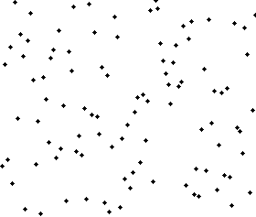
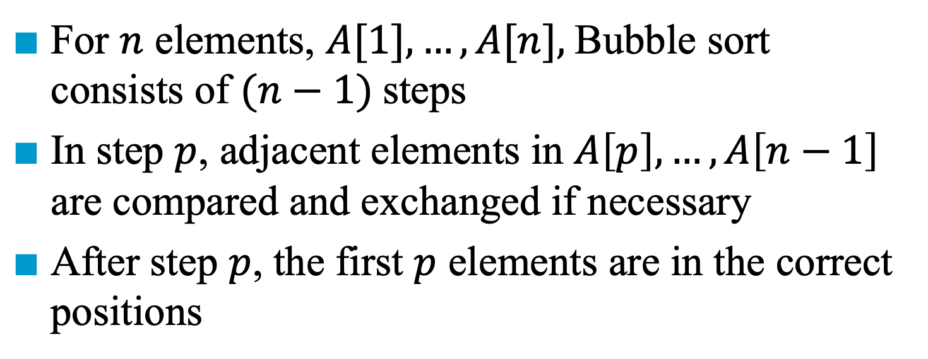
Bubble Sort
For $n$ elements, $A[1], …, A[n],$Bubble sort consists of $(n−1)$steps
In step $p$, adjacent elements in $A\left[p\right],…,A\left[n−1\right]$ are compared and exchanged if necessary
After step $p$, the first $p$ elements are in the correct positions

Slide 20
Bubble Sort
Initial | 26 | 5 | 77 | 1 | 61 | 11 | 59 | 15 | 48 | 19
Step 1 | 26 | 5 | 77 | 1 | 61 | 11 | 59 | 15 | 19 | 48
 | 26 | 5 | 77 | 1 | 61 | 11 | 59 | 15 | 19 | 48
 | 26 | 5 | 77 | 1 | 61 | 11 | 15 | 59 | 19 | 48
 | 26 | 5 | 77 | 1 | 61 | 11 | 15 | 59 | 19 | 48
 | 26 | 5 | 77 | 1 | 11 | 61 | 15 | 59 | 19 | 48
 | 26 | 5 | 77 | 1 | 11 | 61 | 15 | 59 | 19 | 48
 | 26 | 5 | 1 | 77 | 11 | 61 | 15 | 59 | 19 | 48
 | 26 | 1 | 5 | 77 | 11 | 61 | 15 | 59 | 19 | 48
 | 1 | 26 | 5 | 77 | 11 | 61 | 15 | 59 | 19 | 48

Slide 21
Bubble Sort
Initial | 26 | 5 | 77 | 1 | 61 | 11 | 59 | 15 | 48 | 19
Step 1 | 1 | 26 | 5 | 77 | 11 | 61 | 15 | 59 | 19 | 48
Step 2 | 1 | 5 | 26 | 11 | 77 | 15 | 61 | 19 | 59 | 48
Step 3 | 1 | 5 | 11 | 26 | 15 | 77 | 19 | 61 | 48 | 59
Step 4 | 1 | 5 | 11 | 15 | 26 | 19 | 77 | 48 | 61 | 59
Step 5 | 1 | 5 | 11 | 15 | 19 | 26 | 48 | 77 | 59 | 61
Step 6 | 1 | 5 | 11 | 15 | 19 | 26 | 48 | 59 | 77 | 61
Step 7 | 1 | 5 | 11 | 15 | 19 | 26 | 48 | 59 | 61 | 77
Step 8 | 1 | 5 | 11 | 15 | 19 | 26 | 48 | 59 | 61 | 77
Step 9 | 1 | 5 | 11 | 15 | 19 | 26 | 48 | 59 | 61 | 77

Slide 22
Selection Sort
Hypothesis: we know how to sort k-1 elements
Induction on a special k-th element
Given sorted k-1 elements
Select the minimal element from unsorted as the n-th element by scanning the n-(k-1) sorted elements
Put in correct place by swapping
1
2
…
k-1
k
…
n
 |  | min
Sorted
Unsorted

Slide 23
Selection Sort
Initial | 26 | 5 | 77 | 1 | 61 | 11 | 59 | 15 | 48 | 19
Step 1 | 1 | 5 | 77 | 26 | 61 | 11 | 59 | 15 | 48 | 19
Step 2 | 1 | 5 | 77 | 26 | 61 | 11 | 59 | 15 | 48 | 19
Step 3 | 1 | 5 | 11 | 26 | 61 | 77 | 59 | 15 | 48 | 19
Step 4 | 1 | 5 | 11 | 15 | 61 | 77 | 59 | 26 | 48 | 19
Step 5 | 1 | 5 | 11 | 15 | 19 | 77 | 59 | 26 | 48 | 61
Step 6 | 1 | 5 | 11 | 15 | 19 | 26 | 59 | 77 | 48 | 61
Step 7 | 1 | 5 | 11 | 15 | 19 | 26 | 48 | 77 | 59 | 61
Step 8 | 1 | 5 | 11 | 15 | 19 | 26 | 48 | 59 | 77 | 61
Step 9 | 1 | 5 | 11 | 15 | 19 | 26 | 48 | 59 | 61 | 77

Slide 24
Selection Sort
void selectionSort(element a[], int n)
{
int i, j, temp, minpos;
for (i = 1; i < n; i++) {
minpos = i;
for (j = i+1; j <= n; j++) {
if (a[j].key < a[minpos].key)
minpos = j;
}
temp = a[i]; a[i] = a[minpos];
a[minpos] = temp;
}
}
*Program 1.7: Selection sort (p.11)

Slide 25

Insertion Sort
Hypothesis: we know how to sort k-1 elements
Induction on the k-th element
Given sorted k-1 elements
Put the k-th element in its correct place by scanning the k-1 sorted elements
1
2
…
k-1
k
…
n
 |  | correct
Sorted
Unsorted

Slide 26
Insertion Sort
Find an element smaller than K

Slide 27
Insertion Sort
void insert(element e, element a[], int i)
{
// a[1:i] is the sorted list
// a[0] is used as a stop condition
a[0] = e;
while (e.key < a[i].key)
{
a[i+1] = a[i];
i --;
}
a[i+1] = e;
}
*Program 7.4: Insertion into a sorted list (p.338)

Slide 28
Insertion Sort
void insertionSort(element a[], int n)
{
int j;
for (j = 1; j < n; j++) {
element temp = a[j];
insert (temp, a, j-1);
}
}
insertionSort(list,n)
*Program 7.5: Insertion sort (p.338)

Slide 29
worst case
i 0 1 2 3 4
- 5 4 3 2 1
1 4 5 3 2 1
2 3 4 5 2 1
3 2 3 4 5 1
4 1 2 3 4 5
Left out of order (LOO)
R_{i} is LOO if R_{i} < max{R_{j}}
best case
i 0 1 2 3 4
- 2 3 4 5 1
1 2 3 4 5 1
2 2 3 4 5 1
3 2 3 4 5 1
4 1 2 3 4 5
0≤j<i
O(n)

Slide 30
R_{i} is LOO if R_{i} < max{R_{j}}
k: # of LOO records
Computing time: O((k+1)n)
44 55 12 42 94 18 06 67
*
*
*
*
*
Notes:
最壞就是每個位置錯誤的，都要跑到最前面，因此就是 kn 等級

Slide 31
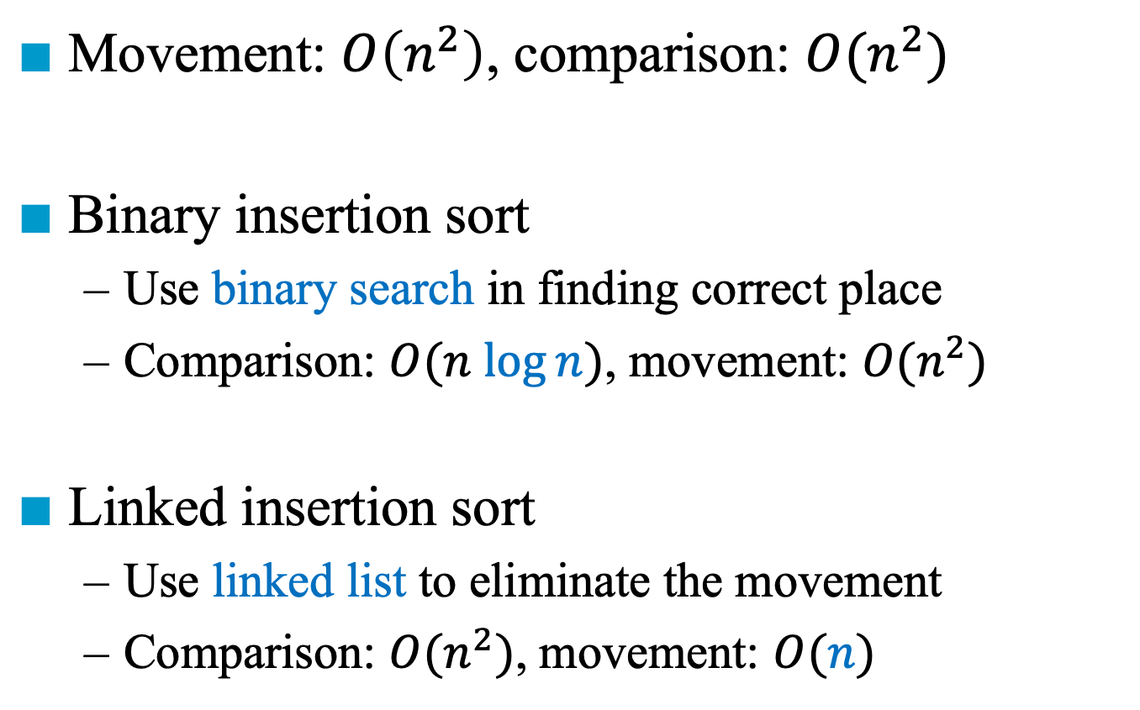
Variations of Insertion Sort
Movement: $O\left(n^{2}\right)$, comparison: $O(n^{2})$
Binary insertion sort
Use binary search in finding correct place
Comparison: $O(n log⁡n)$, movement: $O(n^{2})$
Linked insertion sort
Use linked list to eliminate the movement
Comparison: $O(n^{2})$, movement: $O(n)$

Slide 33
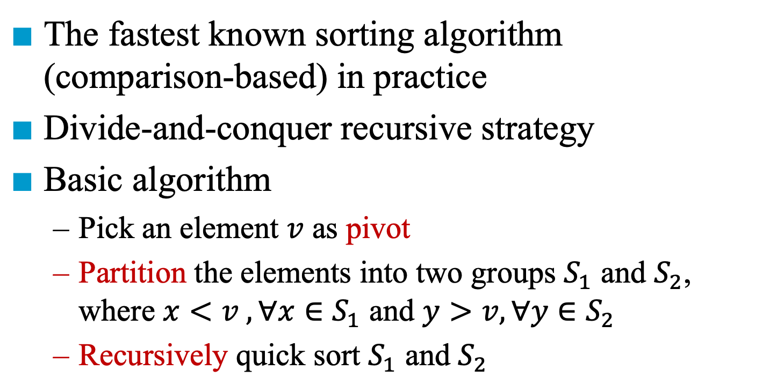
Quick Sort
The fastest known sorting algorithm (comparison-based) in practice
Divide-and-conquer recursive strategy
Basic algorithm
Pick an element $v$ as pivot
Partition the elements into two groups $S_{1}$ and $S_{2}$, where $x<v ,∀x∈S_{1}$ and $y>v,∀y∈S_{2}$
Recursively quick sort $S_{1}$ and $S_{2}$

Slide 34
Example for Quick Sort
{
}
{
}
{
}
{
}
{
}
{
}
{
}
{
}
{
}
{
}

Slide 35
Example for Quick Sort
{
}
{
}
{
}
{
}
{
}
{
}
{
}
{
}
{
}
{
}

Slide 36
Example for Quick Sort
> 26
{
}
{
}
{
}
{
}
{
}
{
}
{
}
{
}
{
}
{
}

Slide 37
Example for Quick Sort
> 26
< 26
{
}
{
}
{
}
{
}
{
}
{
}
{
}
{
}
{
}
{
}

Slide 38
Example for Quick Sort
SWAP
> 26
< 26
{
}
{
}
{
}
{
}
{
}
{
}
{
}
{
}
{
}
{
}

Slide 39
Example for Quick Sort
> 26
< 26
{
19
}
37
{
}
{
}
{
}
{
}
{
}
{
}
{
}
{
}
{
}

Slide 40
Example for Quick Sort
SWAP
> 26
< 26
{
19
}
37
{
}
{
}
{
}
{
}
{
}
{
}
{
}
{
}
{
}

Slide 41
Example for Quick Sort
< 26
> 26
{
19
15
61
}
37
{
}
{
}
{
}
{
}
{
}
{
}
{
}
{
}
{
}

Slide 42
Example for Quick Sort
SWAP
< 26
{
19
15
61
}
37
{
}
{
}
{
}
{
}
{
}
{
}
{
}
{
}
{
}

Slide 43
Example for Quick Sort
{
11
19
15
26
61
}
37
{
}
{
}
{
}
{
}
{
}
{
}
{
}
{
}
{
}

Slide 44
Example for Quick Sort
{
}
{
}
{
}
{
}
{
}
{
}
{
}
{
}
{
}
{
}

Slide 45
Quick Sort
void quickSort(element a[], int left, int right)
{
int pivot, i, j;
element temp;
if (left < right) {
i = left; j = right+1;
pivot = a[left].key;
do {
do i++; while (a[i].key < pivot);
do j--; while (a[j].key > pivot);
if (i < j) SWAP(a[i], a[j], temp);
} while (i < j);
SWAP(a[left], a[j], temp);
quickSort(a, left, j-1);
quickSort(a, j+1, right);
}
}

Slide 46
Picking the Pivot
A naïve way: the first or the last element
A safe maneuver: choose pivot randomly with the cost of random number generation
Median-of-three partitioning:
Base choice: the median value (how to find?)
Estimate:
Pick three elements randomly and use the median
Use the median of the left, right, and center element

Slide 47
Improvement of Quicksort
Quick sort does not perform well for small arrays
Use insertion sort for small arrays (e.g., n < 30)

Slide 48
Analysis for Quick Sort
T(n) is the time taken to sort n elements
Recurrence Relation:
T(0) = 0 and T(1) = 1
T(n) = T(i) + T(n-i-1) + cn, where c is some constant
Worst case:
T(n) = T(n-1) + cn = T(n-2) + 2cn = … = O(n²)
Best case: the list is divided into two even lists
T(n) <= cn + 2T(n/2) <= cn + 2(cn/2 + 2T(n/4)) <= 2 cn + 4T(n/4) <= 3 cn + 8T(n/8) <= k cn + 2^{k} T(n/2^{k}) Set k = log n <= c n log n + nT(1) = O(n log n)

Slide 49
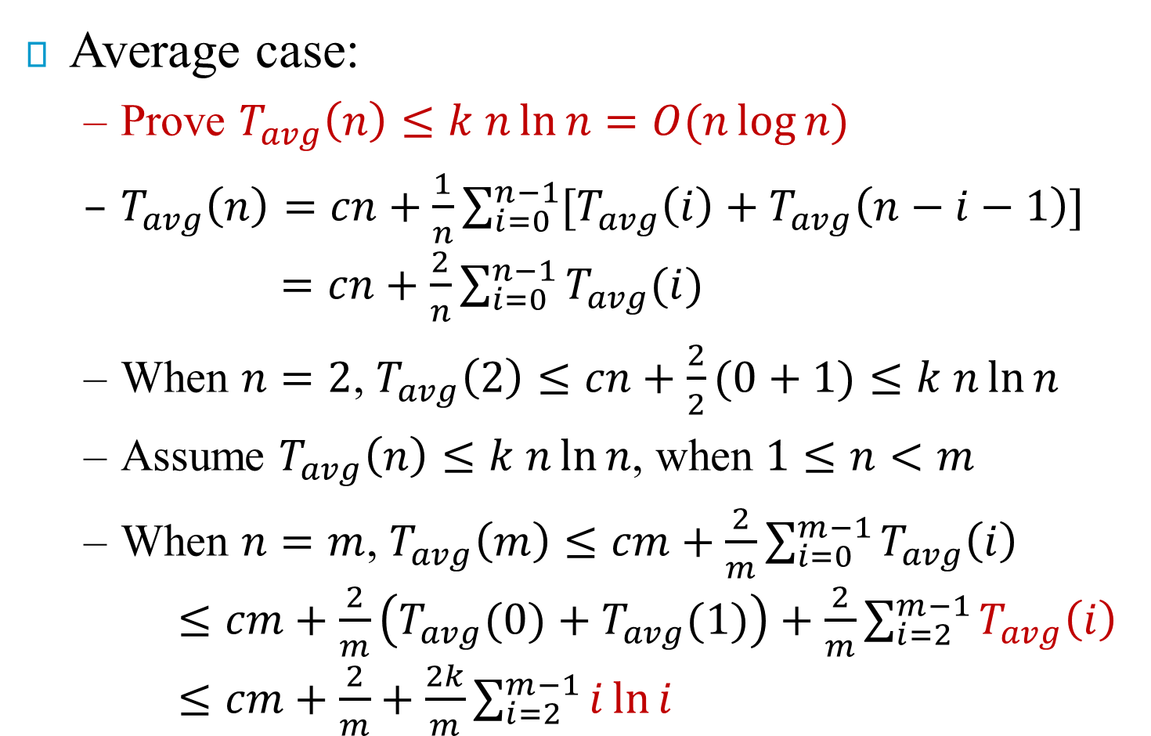
Analysis for Quick Sort
Average case:
Prove $T_{avg}\left(n\right)≤k n\ln{n}=O(n\log{n})$
$T_{avg}\left(n\right)=cn+\frac{1}{n}\sum_{i=0}^{n−1}{[T_{avg}\left(i\right)+T_{avg}\left(n−i−1\right)]}$ $=cn+\frac{2}{n}\sum_{i=0}^{n−1}{T_{avg}(i)}$
When $n=2$, $T_{avg}\left(2\right)≤cn+\frac{2}{2}(0+1)≤k n\ln{n}$
Assume $T_{avg}\left(n\right)≤k n\ln{n}$, when $1≤n<m$
When $n=m$, $T_{avg}\left(m\right)≤cm+\frac{2}{m}\sum_{i=0}^{m−1}{T_{avg}\left(i\right)}$ $≤cm+\frac{2}{m}\left(T_{avg}(0)+T_{avg}(1)\right)+\frac{2}{m}\sum_{i=2}^{m−1}{T_{avg}\left(i\right)}$ $≤cm+\frac{2}{m}+\frac{2k}{m}\sum_{i=2}^{m−1}{i\ln{i}}$

Slide 50
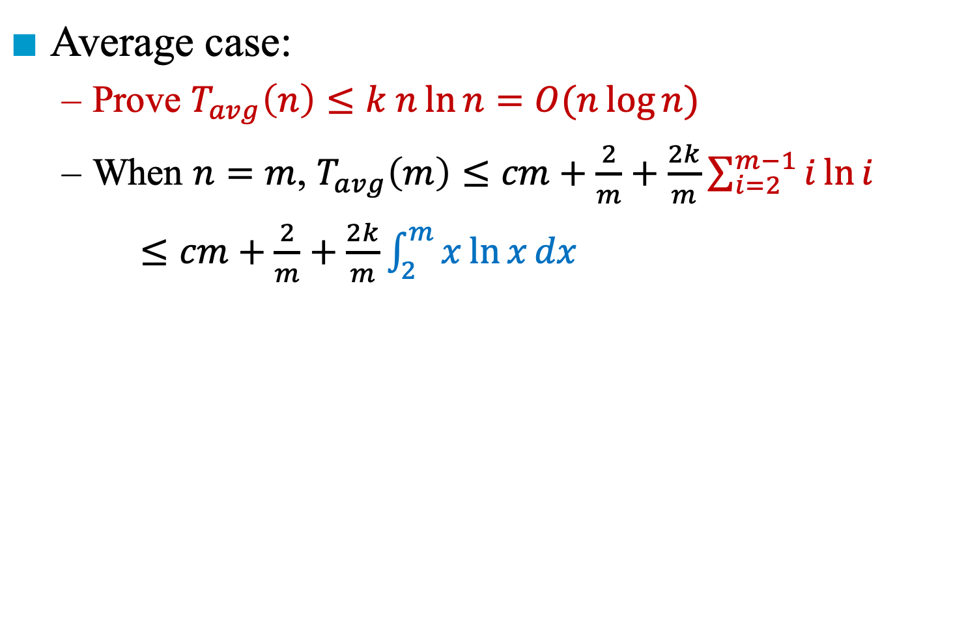
Analysis for Quick Sort
Average case:
Prove $T_{avg}\left(n\right)≤k n\ln{n}=O(n\log{n})$
When $n=m$, $T_{avg}\left(m\right)≤cm+\frac{2}{m}+\frac{2k}{m}\sum_{i=2}^{m−1}{i\ln{i}}$
$≤cm+\frac{2}{m}+\frac{2k}{m}\int_{2}^{m}{x\ln{x}dx}$
$≤cm+\frac{2}{m}+\frac{2k}{m}\left[\frac{m^{2}\log{m}}{2}−\frac{m^{2}}{4}\right]$ (by integration by parts) $≤cm+1+km\log{m}−\frac{k m}{2}$ (because $m≥2$)
Set $k>\frac{2\left(cm+1\right)}{m}$, for $m≥2$ $≤k m\log{m}$

Slide 51
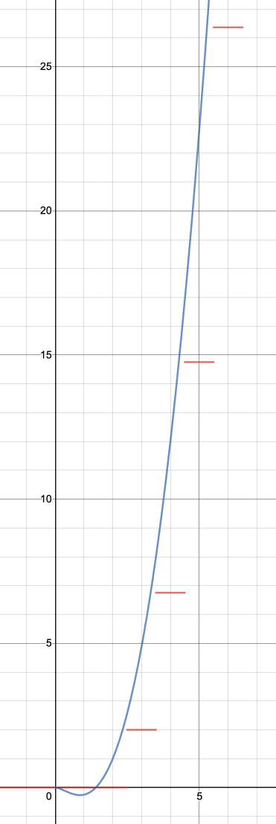
Analysis for Quick Sort
Average case:
Prove $T_{avg}\left(n\right)≤k n\ln{n}=O(n\log{n})$
When $n=m$, $T_{avg}\left(m\right)≤cm+\frac{2}{m}+\frac{2k}{m}\sum_{i=2}^{m−1}{i\ln{i}}$
$≤cm+\frac{2}{m}+\frac{2k}{m}\int_{2}^{m}{x\ln{x}dx}$
$≤cm+\frac{2}{m}+\frac{2k}{m}\left[\frac{m^{2}\log{m}}{2}−\frac{m^{2}}{4}\right]$ (by integration by parts) $≤cm+1+km\log{m}−\frac{k m}{2}$ (because $m≥2$)
Set $k>\frac{2\left(cm+1\right)}{m}$, for $m≥2$ $≤k m\log{m}$

Slide 52
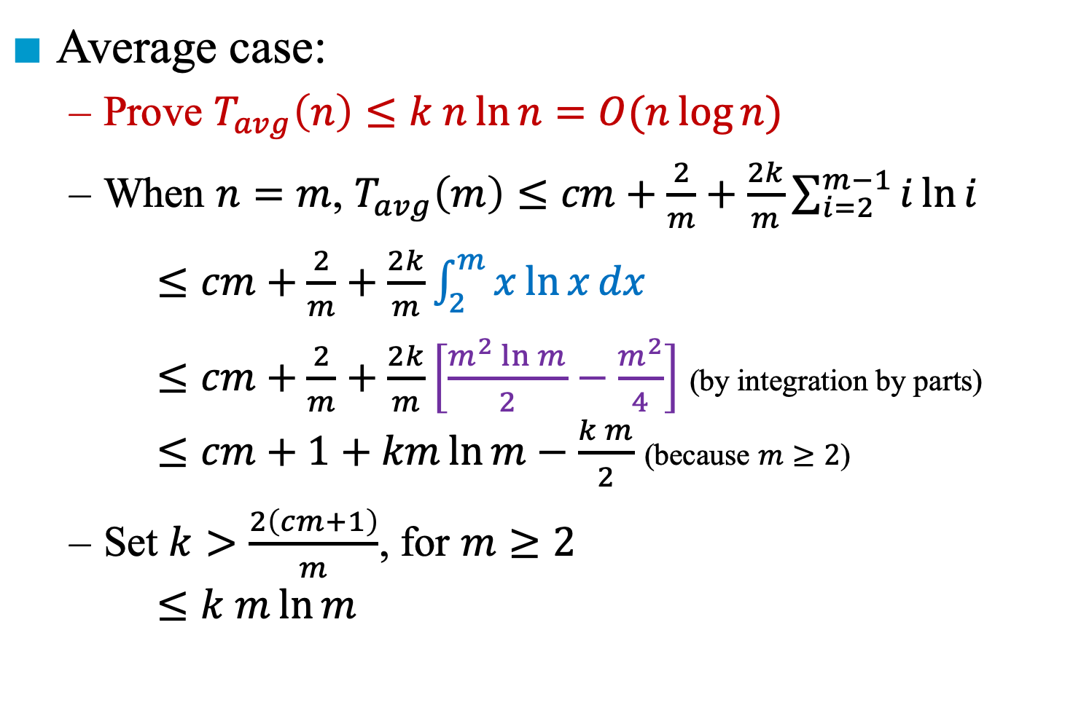
Analysis for Quick Sort
Average case:
Prove $T_{avg}\left(n\right)≤k n\ln{n}=O(n\log{n})$
When $n=m$, $T_{avg}\left(m\right)≤cm+\frac{2}{m}+\frac{2k}{m}\sum_{i=2}^{m−1}{i\ln{i}}$
$≤cm+\frac{2}{m}+\frac{2k}{m}\int_{2}^{m}{x\ln{x}dx}$
$≤cm+\frac{2}{m}+\frac{2k}{m}\left[\frac{m^{2}\ln{m}}{2}−\frac{m^{2}}{4}\right]$ (by integration by parts) $≤cm+1+km\ln{m}−\frac{k m}{2}$ (because $m≥2$)
Set $k>\frac{2\left(cm+1\right)}{m}$, for $m≥2$ $≤k m\ln{m}$
Notes:
u = ln x, du = 1/x dx
dv = x dx, v = ½ x^2
積分 u dv = uv – 積分 v du

Slide 53
Time and Space for Quick Sort
Time complexity:
Average case and best case: O(n log n)
Worst case: O(n²)
Space complexity (i.e., tree depth):
Average case and best case: O(log n)
Worst case: O(n)
Can be improved to O(log n) by tail recursion
First solve sub-problem with a smaller size
Call recursion only when the sub-problem is small enough

Slide 54
Quick Sort (Tail Recursion)
void quickSort(element a[], int left, int right)
{
int pivot, i, j;
element temp;
while (left < right) {
i = left; j = right+1;
pivot = a[left].key;
do {
do i++; while (a[i].key < pivot);
do j--; while (a[j].key > pivot);
if (i < j) SWAP(a[i], a[j], temp);
} while (i < j);
SWAP(a[left], a[j], temp);
if ( j - left < right - j ) {
quickSort(a, left, j-1);
left = j + 1;
}
else {
quickSort(a, j+1, right);
right = j - 1;
}
}
}

Slide 56
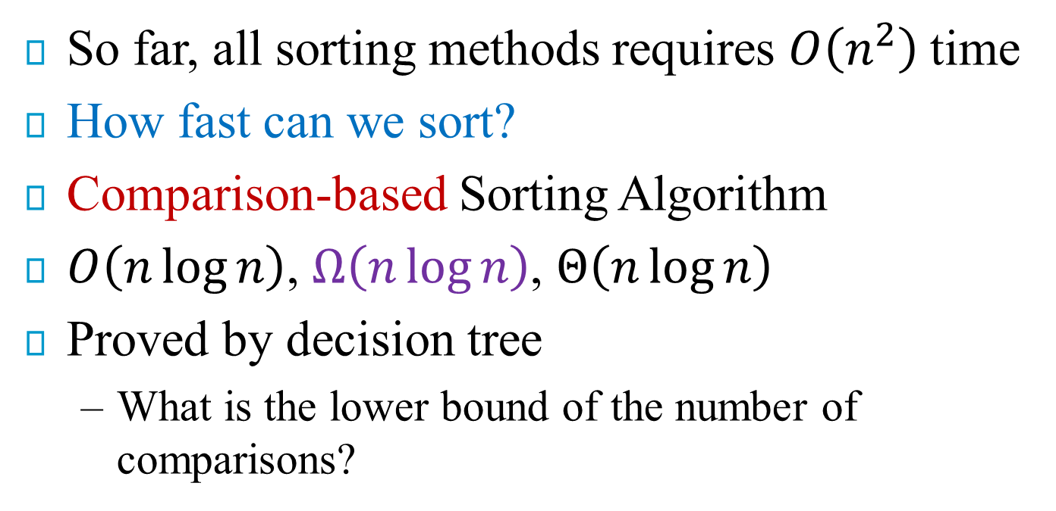
General Lower Bound for Sorting
So far, all sorting methods requires $O\left(n^{2}\right)$time
How fast can we sort?
Comparison-based Sorting Algorithm
$O\left(n\log{n}\right)$, $Ω\left(n\log{n}\right)$, $Θ\left(n\log{n}\right)$
Proved by decision tree
What is the lower bound of the number of comparisons?

Slide 57
Decision Tree for Sorting Three Elements
A < B < C
A < C < B
B < A < C
B < C < A
C < A < B
C < B < A
A < B
A > B
A < B < C
A < C < B
C < A < B
B < A < C
B < C < A
C < B < A
B < C
B > C
A < C
A > C
A < B < C
A < C < B
C < A < B
B < A < C
B < C < A
C < B < A
A < C
A > C
B < C
C < B
A < C < B
C < A < B
B < C < A
C < B < A

Slide 58
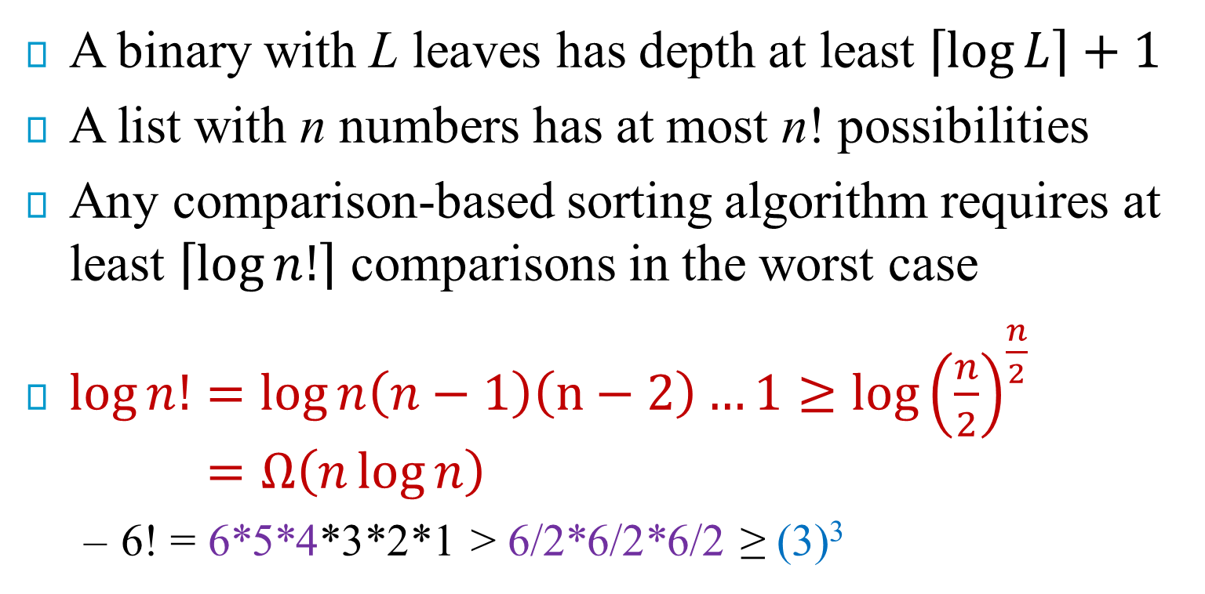
Proof of Lower Bound of Sorting
A binary with L leaves has depth at least $\left\lceil log⁡L\right\rceil +1$
A list with n numbers has at most n! possibilities
Any comparison-based sorting algorithm requires at least $\left\lceil log⁡n!\right\rceil$ comparisons in the worst case
$\log{n!}=\log{n\left(n−1\right)\left(n−2\right)…1}≥\log{{\left(\frac{n}{2}\right)}^{\frac{n}{2}}}$ $=Ω\left(n\log{n}\right)$
6! = 6*5*4*3*2*1 > 6/2*6/2*6/2 ≥ (3)³

Slide 60
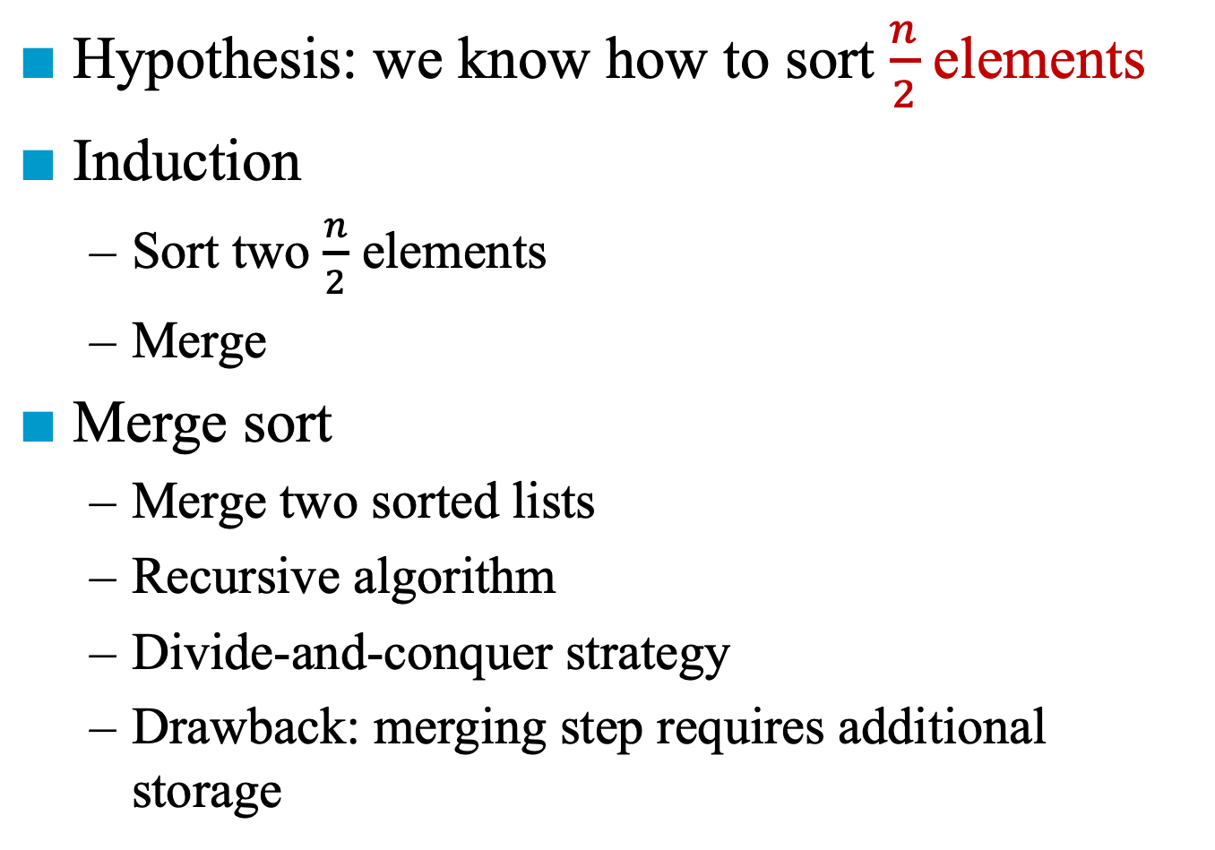
Merge Sort
Hypothesis: we know how to sort $\frac{n}{2}$ elements
Induction
Sort two $\frac{n}{2}$ elements
Merge
Merge sort
Merge two sorted lists
Recursive algorithm
Divide-and-conquer strategy
Drawback: merging step requires additional storage
n/2 elements
n/2 elements
Sorted
Sorted

Slide 61
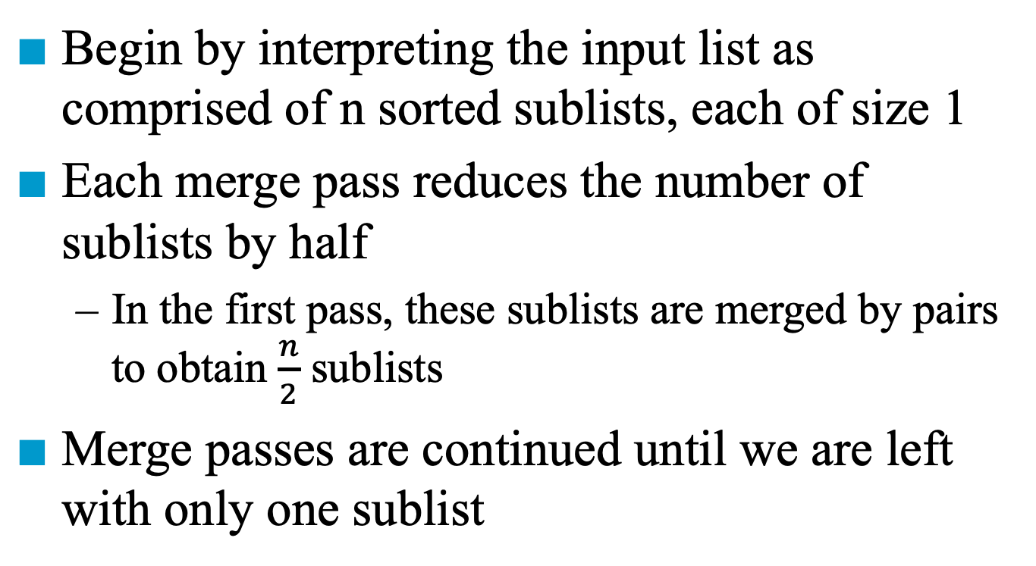
Iterative Merge Sort
Begin by interpreting the input list as comprised of n sorted sublists, each of size 1
Each merge pass reduces the number of sublists by half
In the first pass, these sublists are merged by pairs to obtain $\frac{n}{2}$ sublists
Merge passes are continued until we are left with only one sublist

Slide 62
Iterative Merge Sort
Sort 26, 5, 77, 1, 61, 11, 59, 15, 48, 19
Pass 1
Pass 2
Pass 3
Pass 4
Pass 5

Slide 63
Merge Sort
void mergeSort(element a[], int n)
{
int s = 1;
element extra[MAX_SIZE];
while (s < n) {
mergePass(a, extra, n, s);
s *= 2;
mergePass(extra, a, n, s);
s *= 2;
}
}
a
l
l
l
l
...
extra
2
2
...
a
4
...
⎡log n⎤ passes

Slide 64
MergePass
void mergePass(element initList[], element mergedList[],
int n, int s)
{
int i, j;
for (i = 1; i <= n – 2 * s + 1; i += 2 * s)
merge(initList,mergedList,i, i + s - 1, i + 2 * s - 1);
if ( i + s - 1 < n)
merge(initList, mergedList, i, i + s - 1, n);
else
for (j = i; j <= n; j++)
mergedList[j]= initList[j];
}
One complement segment and one partial segment
Only one segment
i
i + s - 1
i + 2 * s - 1
...
2 * s
...

Slide 65
Merging
void merge(element initList[], element mergedList[],
int i, int m, int n)
{
int j, k, t;
j = m+1;
k = i;
while (i <= m && j <= n) {
if (initList[i].key <= initList[j].key)
mergedList[k++] = initList[i++];
else
mergedList[k++] = initList[j++];
}
if (i > m)
for (t = j; t <= n; t++)
mergedList[k+t-j]= initList[t];
else
for (t = i; t <= m; t++)
mergedList[k+t-i] = initList[t];
}
Additional space: n-i+1 = O(n)
# of copies: O(n-i+1) = O(n)

Slide 66
Time Complexity
Recurrence Relation:
T(1) = 1
T(n) = 2 T(n/2) + n
Time Complexity
T(n) = 2 T(n/2) + n = 2 [ 2 T(n/4) + n/2 ] + n = 4 T(n/4) + 2n = 8 T(n/8) + 3n = …
T(n) = 2^{k} T(n/2^{k}) + kn
Set k = log n ➔ T(n) = n T(1) + n log n = O(n log n)
n/2 elements
n/2 elements
Sorted
Sorted

Slide 67
Space Analysis
Array vs. linked list representation
Array: O(s(n-i+1)) where s is the record size
Linked list representation: O(n-i+1) Each record is associated with a link field ➔ O(n-i+1)
element extra[MAX_SIZE];
int link[MAX_SIZE];
// list is used to store the position of the
// next record

Slide 68
Linked List Representation
int link[MAX_SIZE];
// list is used to store the position of the
// next record
start = 4

Slide 69
Recursive Merge Sort
The list are divided into two roughly equal parts called the left and the right sublists
These two sublists are sorted recursively
Then, the sorted sublists are merged

Slide 70
Recursive Formulation of Merge Sort
26 5 77 1 61 11 59 15 48 19
5 26 11 59
copy
copy
copy
copy
5 26 77 1 61 11 15 59 19 48
1 5 26 61 77 11 15 19 48 59
⎣(1+5)/2⎦
⎣(6+10)/2⎦
1 5 11 15 19 26 48 59 61 77
⎣(1+10)/2⎦
Data Structure: array (copy subfiles) vs. linked list (no copy)

Slide 71
Linked List Representation
Merge
Return 2

Slide 72
Linked List Representation
Merge
Return 2

Slide 73
Linked List Representation
Merge
Return 4

Slide 74
Linked List Representation
Merge
Return 4

Slide 75
Linked List Representation
Merge
…

Slide 76
Recursive Merge Sort
left
right
Point to the start of sorted chain
int rmergeSort(element a[], int link[],
int left, int right)
{
int mid;
if (left >= right) return left;
mid = (left + right) / 2;
return listMerge(a, link,
rmergeSort(a,link,left,mid),
rmergeSort(a,link,mid+1,right));
}
left
mid
right

Slide 77
Merge Two Sublists Using link
int listMerge(element a[], int link[],
int start1, int start2)
{
int last1, last2, lastResult = 0;
for (last1 = start1, last2 = start2; last1 && last2; ) {
if (a[last1] <= a[last2]) {
/* key in first list is lower, link this
element to start and change start to
point to first */
link[lastResult] = last1;
lastResult = last1;
last1 = link[last1];
}
link[last1]
link[0]
link[lastResult]
...
…
link[last2]

Slide 78
else {
/* key in second list is lower, link this
element into the partially sorted list */
link[lastResult] = last2;
lastResult = last2;
last2 = link[last2];
}
}
if (last1==0)
link[lastResult] = last2;
else
link[lastResult] = last1;
return link[0];
}
Left sublist is exhausted
Right sublist is exhausted
O(n log n)

Slide 79
Nature Merge Sort
The initial pass over the data determines the sublists of records that are in order
26 5 77 1 61 11 59 15 48 19
5 26 77
1 11 59 61
15 19 48
1 5 11 26 59 61 77
15 19 48
1 5 11 15 19 26 48 59 61 77

Slide 81
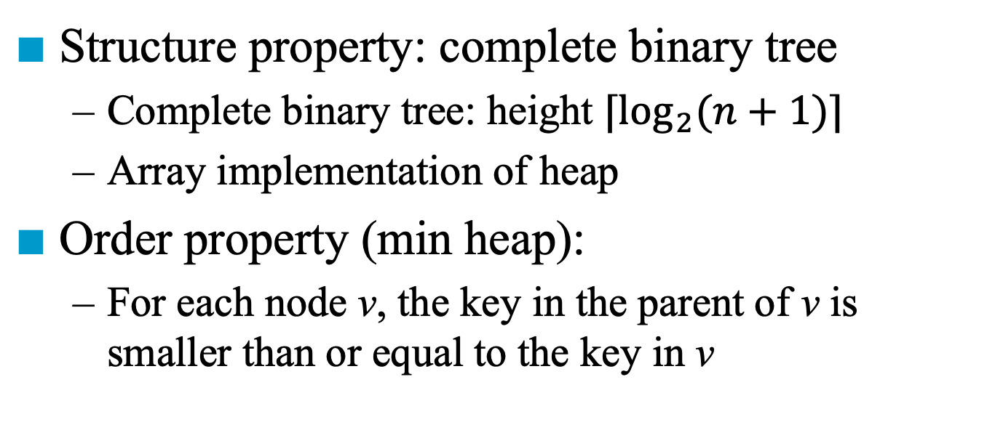
Heap
Structure property: complete binary tree
Complete binary tree: height $⌈\log_{2}{(n+1)}⌉$
Array implementation of heap
Order property (min heap):
For each node v, the key in the parent of v is smaller than or equal to the key in v
2
7
4
- | 2 | 7 | 4 | 10 | 8 | 6
10
8
6

Slide 82
Heap Sort
Naïve Algorithm (non-decreasing order)
Step 1: build min heap
Step 2: for (i = 0; i < n; i++) pop();
Drawback: additional space O(n) for heap
2
7
4
- | 2 | 7 | 4 | 10 | 8 | 6
10
8
6

Slide 83
Heap Sort
Improved Algorithm (non-decreasing order)
Step 1: build max heap
Step 2: for (i = n; i > 0; i++) a[i] = pop();
10
8
6
- | 10 | 8 | 6 | 4 | 7 | 2
4
7
2

Slide 84
*Figure 7.7: Array interpreted as binary tree (p.354)
Heap Sort
Input array: 26 5 77 1 61 11 59 15 48 19
[1]
77
[2]
61
[3]
59
exchange
[4]
48
[5]
19
[6]
11
[7]
26
[8]
15
[9]
1
[10]
5
(b) Initial heap

Slide 85
Figure 7.8: Heap sort example (p.355)
[1]
61
[2]
48
[3]
59
15
19
11
[7]
26
[4]
[5]
[6]
[8]
5
[9]
1
[10]
77
(a)
[1]
59
[2]
48
[3]
26
15
19
11
[7]
1
[4]
[5]
[6]
[8]
5
[9]
61
[10]
77
(b)

Slide 86
[1]
48
[2]
19
[3]
26
15
5
11
[7]
1
[4]
[5]
[6]
59
59
61
[8]
[9]
61
[10]
77
(c)
[1]
26
[2]
19
[3]
11
48
15
5
1
[7]
48
[4]
[5]
[6]
59
[8]
59
[9]
61
[10]
77
(d)
Figure 7.8: Heap sort example (p.355)

Slide 87
Heap Sort
Improved Algorithm (non-decreasing order)
Step 1: build max heap
How to arrange records so that the entire binary tree is a max heap
Step 2: for (i = n; i > 0; i++) a[i] = pop();
10
8
6
- | 10 | 8 | 6 | 4 | 7 | 2
4
7
2

Slide 88
*Figure 7.7: Array interpreted as a binary tree (p.354)
Adjust array to max heap
Index 1 2 3 4 5 6 7 8 9 10
26 5 77 1 61 11 59 15 48 19
We use a bottom-up method
[1]
26
[2]
5
[3]
77
[4]
1
[5]
61
[6]
11
[7]
59
[8]
15
[9]
48
[10]
19
(a) Input array

Slide 89
Adjust array to max heap
Index 1 2 3 4 5 6 7 8 9 10
26 5 77 1 61 11 59 15 48 19
We use a bottom-up method
[1]
26
[2]
5
[3]
77
[4]
1
[5]
61
[6]
11
[7]
59
[8]
15
[9]
48
[10]
19

Slide 90
Adjust array to max heap
Index 1 2 3 4 5 6 7 8 9 10
26 5 77 1 61 11 59 15 48 19
We use a bottom-up method
[1]
26
[2]
5
[3]
77
[4]
1
[5]
61
[6]
11
[7]
59
[8]
15
[9]
48
[10]
19

Slide 91
Adjust array to max heap
Index 1 2 3 4 5 6 7 8 9 10
26 5 77 48 61 11 59 15 1 19
We use a bottom-up method
[1]
26
[2]
5
[3]
77
[4]
48
[5]
61
[6]
11
[7]
59
[8]
15
[9]
1
[10]
19

Slide 92
Adjust array to max heap
Index 1 2 3 4 5 6 7 8 9 10
26 5 77 48 61 11 59 15 1 19
We use a bottom-up method
[1]
26
[2]
5
[3]
77
[4]
48
[5]
61
[6]
11
[7]
59
[8]
15
[9]
1
[10]
19

Slide 93
Adjust array to max heap
Index 1 2 3 4 5 6 7 8 9 10
26 5 77 48 61 11 59 15 1 19
We use a bottom-up method
[1]
26
[2]
5
[3]
77
[4]
48
[5]
61
[6]
11
[7]
59
[8]
15
[9]
1
[10]
19

Slide 94
Adjust array to max heap
Index 1 2 3 4 5 6 7 8 9 10
26 61 77 48 19 11 59 15 1 5
We use a bottom-up method
[1]
26
[2]
61
[3]
77
[4]
48
[5]
19
[6]
11
[7]
59
[8]
15
[9]
1
[10]
5

Slide 95
Adjust array to max heap
Index 1 2 3 4 5 6 7 8 9 10
26 61 77 48 19 11 59 15 1 5
We use a bottom-up method
[1]
26
[2]
61
[3]
77
[4]
48
[5]
19
[6]
11
[7]
59
[8]
15
[9]
1
[10]
5

Slide 96
Adjust array to max heap
Index 1 2 3 4 5 6 7 8 9 10
77 61 59 48 19 11 26 15 1 5
We use a bottom-up method
[1]
77
[2]
61
[3]
59
[4]
48
[5]
19
[6]
11
[7]
26
[8]
15
[9]
1
[10]
5

Slide 97
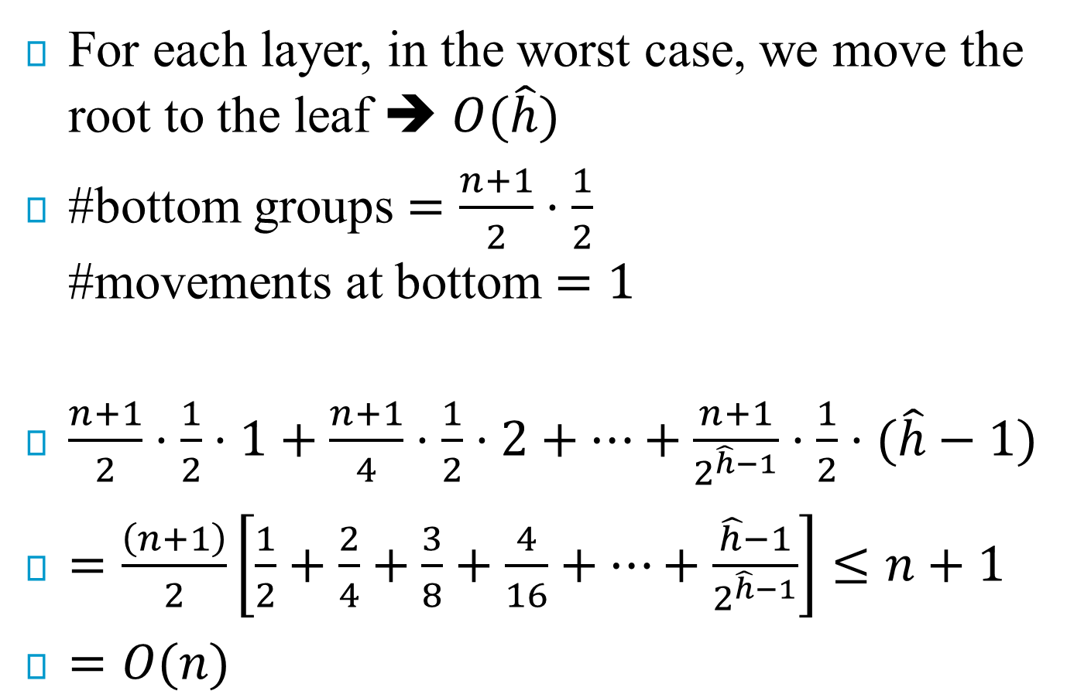
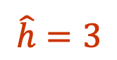


Simple analysis – build max heap
For each layer, in the worst case, we move the root to the leaf ➔ $O(\hat{h})$
#bottom groups $=\frac{n+1}{2}⋅\frac{1}{2}$ #movements at bottom $=1$
$\frac{n+1}{2}⋅\frac{1}{2}⋅1+\frac{n+1}{4}⋅\frac{1}{2}⋅2+…+\frac{n+1}{2^{\hat{h}−1}}⋅\frac{1}{2}⋅(\hat{h}−1)$
$=\frac{\left(n+1\right)}{2}\left[\frac{1}{2}+\frac{2}{4}+\frac{3}{8}+\frac{4}{16}+…+\frac{\hat{h}−1}{2^{\hat{h}−1}}\right]≤n+1$
$=O(n)$
$$\hat{h}=3$$
$$2$$
$$1$$
Notes:
1/2+1/4+1/8+…<=1
1/4+1/8+…<=1-1/2=1/2
1/8+…<=1-1/2-1/4=1/4
…
So 1/2+2/4+3/8+4/16+…<=1+1/2+1/4+1/8+…<=2

Slide 98
Heap Sort
void adjust(element a[], int root, int n)
{
int child, rootkey;
element temp;
temp = list[root];
rootkey = list[root].key;
child = 2*root;
while (child <= n) {
if ((child < n) &&
(list[child].key < list[child+1].key))
child++;
if (rootkey > list[child].key)
break;
else {
list[child/2] = list[child];
child *= 2;
}
}
list[child/2] = temp;
}
Time complexity
O(n log n) → O(n)
// position of left child
// if left child exists
// if right child exists
// if the current root is correct
// if the current root is smaller than child
i
2i
2i+1

Slide 99
Heap Sort
void heapSort(element list[], int n)
{
int i, j;
element temp;
for (i = n/2; i > 0; i--)
adjust(list, i, n);
for (i = n-1; i > 0; i--) {
SWAP(list[1], list[i+1], temp);
adjust(list, 1, i);
}
}
ascending order (max heap)
bottom-up

Slide 101
Bucket Sort
Different from comparison-based algorithms
Steps:
Allocate sufficient number of buckets
Put each element in the corresponding bucket
At then end, scan the buckets in order to collect all the elements
n elements whose keys range from 1 to m → m buckets
Drawback:
Waste buckets (i.e., space)

Slide 102
Radix Sort
Step:
Use several passes of bucket sort
More than one number could fall into the same bucket
Two approaches:
Most-significant-digit-first (MSD): radix-exchange sort
Least-significant-digit-first (LSD): straight-radix sort

Slide 103
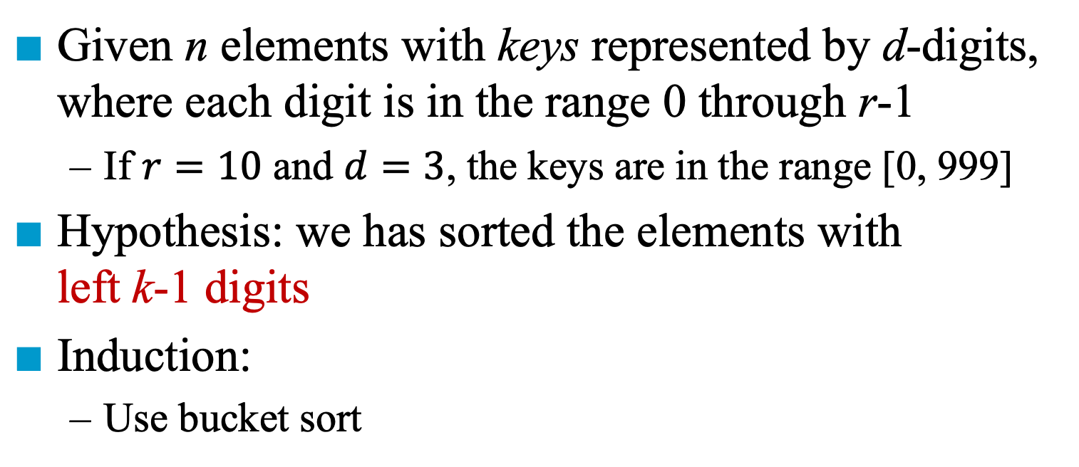
Radix-Exchange Sort
Given n elements with keys represented by d-digits, where each digit is in the range 0 through r-1
If $r=10$ and $d=3$, the keys are in the range [0, 999]
Hypothesis: we has sorted the elements with left k-1 digits
Induction:
Use bucket sort

Slide 104
Example of Radix-Exchange Sort
179, 208, 306, 93, 859, 984, 55, 9, 271, 33
0 | 1 | 2 | 3 | 4 | 5 | 6 | 7 | 8 | 9
033 009 055 093 | 179 | 271 208 | 306 |  |  |  |  | 859 | 984

Slide 105
Example of Radix-Exchange Sort
179, 208, 306, 93, 859, 984, 55, 9, 271, 33
0 | 1 | 2 | 3 | 4 | 5 | 6 | 7 | 8 | 9
033 009 055 093 | 179 | 271 208 | 306 |  |  |  |  | 859 | 984
0 | 1 | 2 | 3 | 4 | 5 | 6 | 7 | 8 | 9
009 |  |  | 033 |  | 055 |  |  |  | 093

Slide 106
Straight-Radix Sort
Given n elements with keys represented by d-digits, where each digit is in the range 0 through r-1
Hypothesis: we has sorted the elements with right k-1 digits
Induction:
Ignore the most significant digit and sort the n elements according to their k-1 least significant digits
Scan all the elements and use bucket sort on the most significant digit
Collect all the buckets in order

Slide 107
Example of Straight-Radix Sort
Input: 179, 208, 306, 93, 859, 984, 55, 9, 271, 33
0 | 1 | 2 | 3 | 4 | 5 | 6 | 7 | 8 | 9
 | 271 |  | 033 093 | 984 | 055 | 306 |  | 208 | 009 859 179
Output: 271, 93, 33, 984, 55, 306, 208, 179, 859, 9

Slide 108
Example of Straight-Radix Sort
Input: 179, 208, 306, 93, 859, 984, 55, 9, 271, 33
1-pass output: 271, 93, 33, 984, 55, 306, 208, 179, 859, 9
0 | 1 | 2 | 3 | 4 | 5 | 6 | 7 | 8 | 9
009 208 306 |  |  | 033 |  | 859 055 |  | 179 271 | 984 | 093
Output: 306, 208, 9, 33, 55, 859, 271, 179, 984, 93

Slide 109
Example of Straight-Radix Sort
Input: 179, 208, 306, 93, 859, 984, 55, 9, 271, 33
1-pass output : 271, 93, 33, 984, 55, 306, 208, 179, 859, 9
2-pass output: 306, 208, 9, 33, 55, 859, 271, 179, 984, 93
0 | 1 | 2 | 3 | 4 | 5 | 6 | 7 | 8 | 9
093 055 033 009 | 179 | 271 208 | 306 |  |  |  |  | 859 | 984
Output: 9, 33, 55, 93, 179, 208, 271, 306, 859, 984

Slide 110
Example for Straight-Radix Sort
d (digit) = 3, r (radix) = 10 ascending order
179, 208, 306, 93, 859, 984, 55, 9, 271, 33
Sort by digit
concatenate
271, 93, 33, 984, 55, 306, 208, 179, 859, 9 After the first pass

Slide 111
271, 93, 33, 984, 55, 306, 208, 179, 859, 9 After the first pass
front[0]
306
208
9
null
rear[0]
front[1]
null
rear[1]
front[2]
null
rear[2]
front[3]
33
null
rear[3]
front[4]
null
rear[4]
front[5]
55
859
null
rear[5]
front[6]
null
rear[6]
front[7]
271
179
null
rear[7]
front[8]
984
null
rear[8]
front[9]
93
null
rear[9]
306, 208, 9, 33, 55, 859, 271, 179, 984, 93 (second pass)

Slide 112
306, 208, 9, 33, 55, 859, 271, 179, 984, 93 (second pass)
front[0]
9
33
55
93
null
rear[0]
front[1]
179
null
rear[1]
front[2]
208
271
null
rear[2]
front[3]
306
null
rear[3]
front[4]
null
rear[4]
front[5]
null
rear[5]
front[6]
null
rear[6]
front[7]
null
rear[7]
front[8]
859
null
rear[8]
front[9]
984
null
rear[9]
9, 33, 55, 93, 179, 208, 271, 306, 859, 984 (third pass)

Slide 113
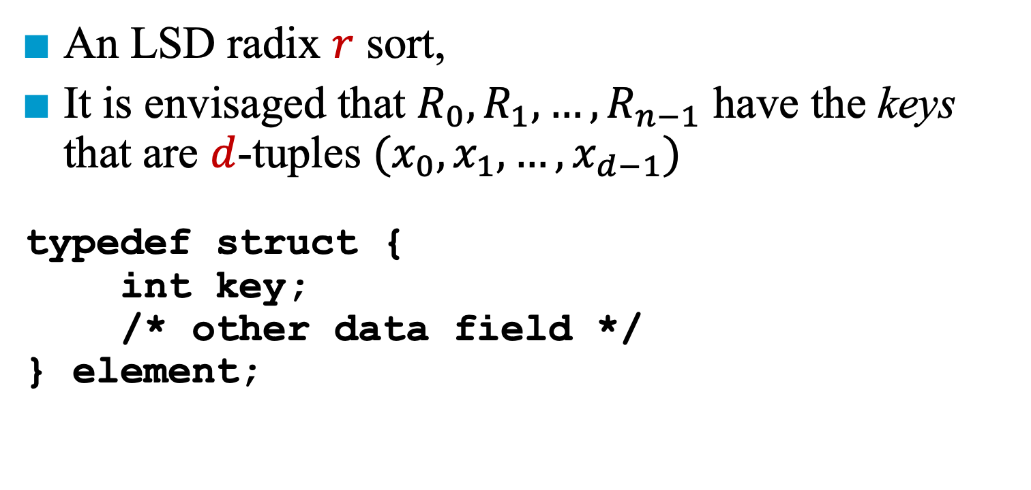
Data Structures for Radix Sort
An LSD radix $r$ sort,
It is envisaged that $R_{0}, R_{1}, …, R_{n−1}$ have the keys that are $d$-tuples $(x_{0}, x_{1}, …, x_{d−1})$
typedef struct {
int key;
/* other data field */
} element;

Slide 114
LSD Radix Sort
int radixSort(element a[], int link[], int d, int r, int n)
{
int front[r], rear[r];
int i, bin, current, first, last;
first = 1;
for (i = 1; i < n; i ++) link[i] = i+1;
link[i] = 0;
for (i = d-1; i >= 0; i --)
{
for (bin = 0; bin < r; bin ++) front[bin] = 0;
for (current = first; current; current = link[current])
{
bin = digit (a[current], i, r);
if (front[bin] == 0) front[bin] = current;
else link[rear[bin]] = current;
rear[bin] = current;
}
// Queue front and rear pointers
// Create initial chain of records starting at first
// Initialize bins to be empty queue
O(r)
// Put records into queues
O(n)

Slide 115
O(d(n+r))
for (bin = 0; !front[bin]; bin ++);
first = front[bin]; last = rear[bin];
for (bin ++; bin < r; bin ++)
if (front[bin]) {
link[last] = front[bin];
last = rear[bin];
}
link[last] = 0;
}
return first;
}
// Find first nonempty queue
// Concatenate remaining queues
O(r)
first
last

Slide 117
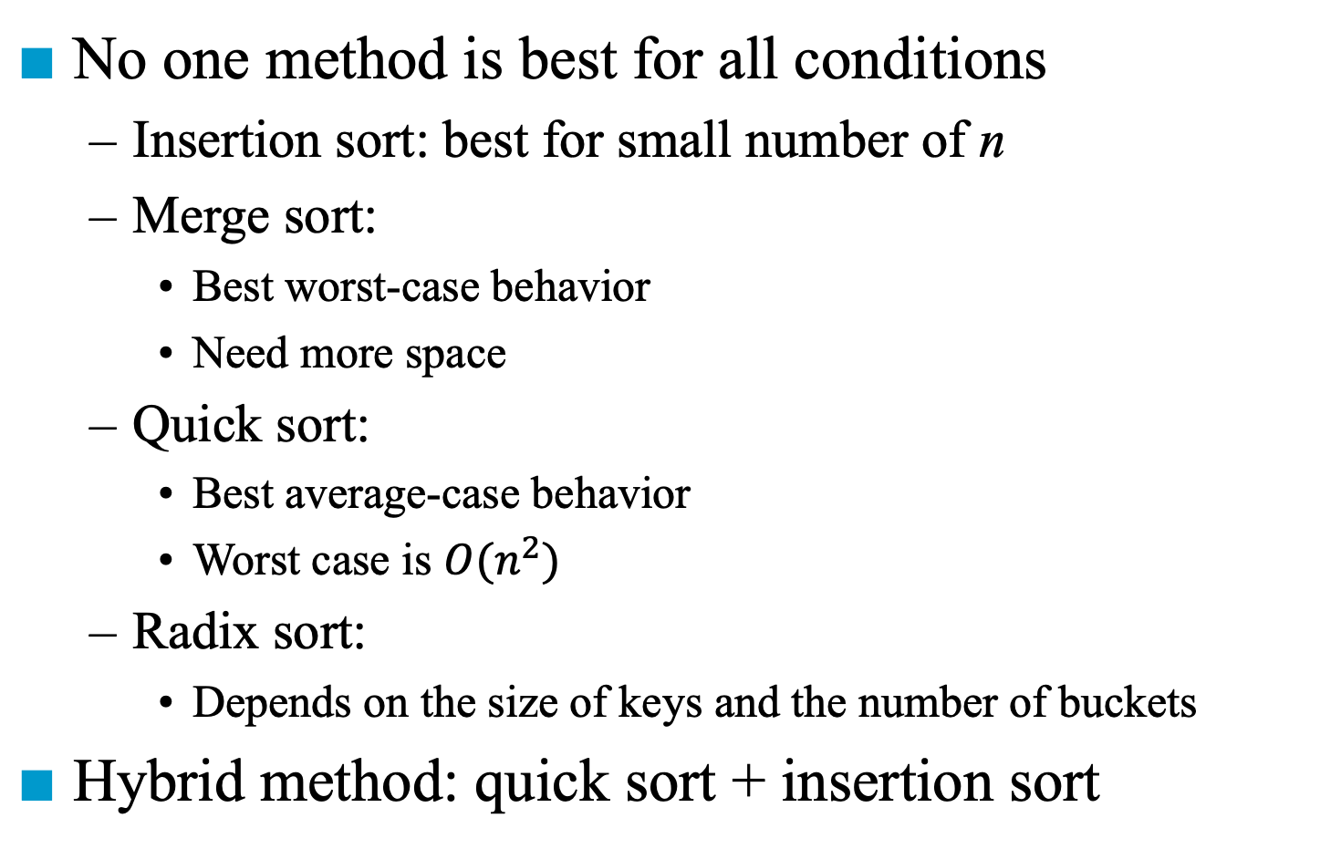
Summary of Internal Sorting
No one method is best for all conditions
Insertion sort: best for small number of n
Merge sort:
Best worst-case behavior
Need more space
Quick sort:
Best average-case behavior
Worst case is $O(n^{2})$
Radix sort:
Depends on the size of keys and the number of buckets
Hybrid method: quick sort + insertion sort

Slide 118
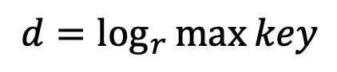
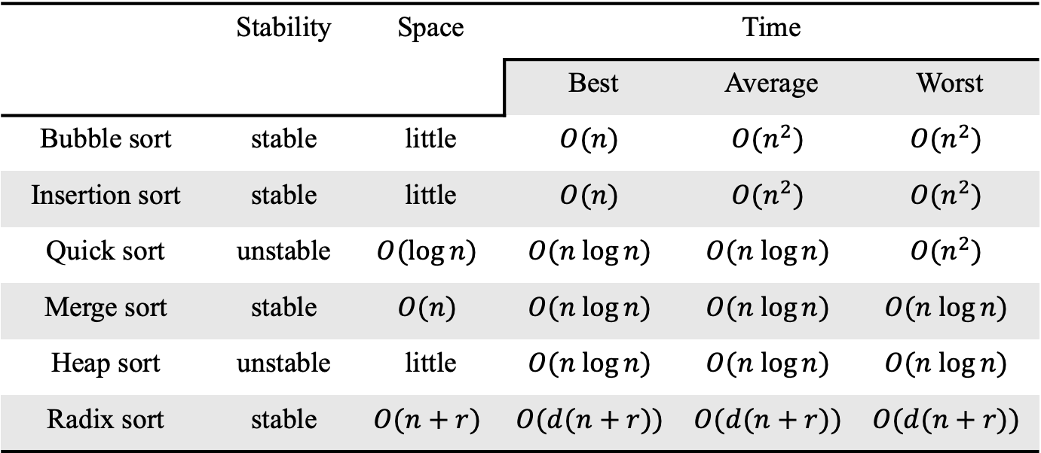
Complexity of Sort
 | Stability | Space | Time
 |  |  | Best | Average | Worst
Bubble sort | stable | little | $$O(n)$$ | $$O(n^{2})$$ | $$O(n^{2})$$
Insertion sort | stable | little | $$O(n)$$ | $$O(n^{2})$$ | $$O(n^{2})$$
Quick sort | unstable | $$O(log⁡n)$$ | $$O(n log⁡n)$$ | $$O(n log⁡n)$$ | $$O(n^{2})$$
Merge sort | stable | $$O(n)$$ | $$O(n log⁡n)$$ | $$O(n log⁡n)$$ | $$O(n log⁡n)$$
Heap sort | unstable | little | $$O(n log⁡n)$$ | $$O(n log⁡n)$$ | $$O(n log⁡n)$$
Radix sort | stable | $$O(n+r)$$ | $$O(d(n+r))$$ | $$O(d(n+r))$$ | $$O(d(n+r))$$
$$d=\log_{r}\max{key}$$

Slide 119
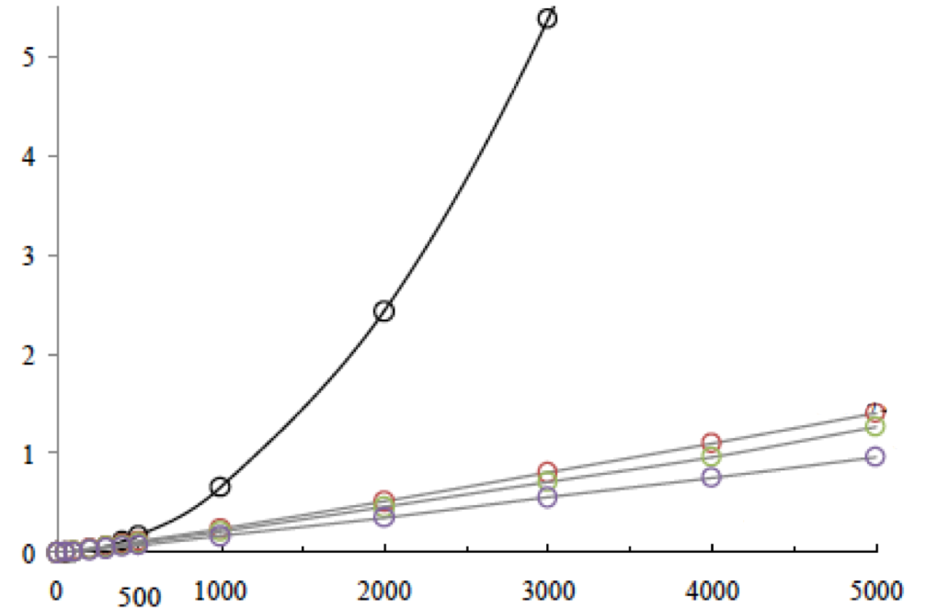
Average Computing Time
Insertion sort
Heap sort
Merge sort
Quick sort

Slide 121
List Sort
All the sorting methods require excessive data movement
The physical data movement tends to slow down the sorting process
When sorting lists with large records, we have to modify the sorting methods so as to minimize data movement
Methods such as insertion sort and merge sort can be modified to work with a linked list representation (e.g., link)
After sorting, we may physically rearrange the records in place

Slide 122
first
In Place Sorting
i | R1 | R2 | R3 | R4 | R5 | R6 | R7 | R8 | R9 | R10
key | 26 | 5 | 77 | 1 | 61 | 11 | 59 | 15 | 48 | 19
linka | 9 | 6 | 0 | 2 | 3 | 8 | 5 | 10 | 7 | 1
R1 <--> R4
i | R1 | R2 | R3 | R4 | R5 | R6 | R7 | R8 | R9 | R10
key | 1 | 5 | 77 | 26 | 61 | 11 | 59 | 15 | 48 | 19
linka | 2 | 6 | 0 | 9 | 3 | 8 | 5 | 10 | 7 | 4
How to know where the predecessor is ?
i.e., its link should be modified

Slide 123
Doubly Linked List
first
Initial
i | R1 | R2 | R3 | R4 | R5 | R6 | R7 | R8 | R9 | R10
key | 26 | 5 | 77 | 1 | 61 | 11 | 59 | 15 | 48 | 19
linka | 9 | 6 | 0 | 2 | 3 | 8 | 5 | 10 | 7 | 1
linkb | 10 | 4 | 5 | 0 | 7 | 2 | 9 | 6 | 1 | 8
i | R1 | R2 | R3 | R4 | R5 | R6 | R7 | R8 | R9 | R10
key | 26 | 5 | 77 | 1 | 61 | 11 | 59 | 15 | 48 | 19
linka | 9 | 6 | 0 | 2 | 3 | 8 | 5 | 10 | 7 | 1
linkb | 10 | 4 | 5 | 0 | 7 | 2 | 9 | 6 | 1 | 8
i | R1 | R2 | R3 | R4 | R5 | R6 | R7 | R8 | R9 | R10
key | 1 | 5 | 77 | 26 | 61 | 11 | 59 | 15 | 48 | 19
linka | 2 | 6 | 0 | 9 | 3 | 8 | 5 | 10 | 7 | 4
linkb | 0 | 4 | 5 | 10 | 7 | 2 | 9 | 6 | 4 | 8

Slide 124
Doubly Linked List
R1 is in place
i | R1 | R2 | R3 | R4 | R5 | R6 | R7 | R8 | R9 | R10
key | 1 | 5 | 77 | 26 | 61 | 11 | 59 | 15 | 48 | 19
linka | 2 | 6 | 0 | 9 | 3 | 8 | 5 | 10 | 7 | 4
linkb | 0 | 4 | 5 | 10 | 7 | 2 | 9 | 6 | 4 | 8
i | R1 | R2 | R3 | R4 | R5 | R6 | R7 | R8 | R9 | R10
key | 26 | 5 | 77 | 1 | 61 | 11 | 59 | 15 | 48 | 19
linka | 9 | 6 | 0 | 2 | 3 | 8 | 5 | 10 | 7 | 1
linkb | 10 | 4 | 5 | 0 | 7 | 2 | 9 | 6 | 1 | 8
i | R1 | R2 | R3 | R4 | R5 | R6 | R7 | R8 | R9 | R10
key | 1 | 5 | 77 | 26 | 61 | 11 | 59 | 15 | 48 | 19
linka | 2 | 6 | 0 | 9 | 3 | 8 | 5 | 10 | 7 | 4
linkb | 0 | 4 | 5 | 10 | 7 | 2 | 9 | 6 | 4 | 8

Slide 125
Doubly Linked List
R1 and R2 are in place
i | R1 | R2 | R3 | R4 | R5 | R6 | R7 | R8 | R9 | R10
key | 1 | 5 | 77 | 26 | 61 | 11 | 59 | 15 | 48 | 19
linka | 2 | 6 | 0 | 9 | 3 | 8 | 5 | 10 | 7 | 4
linkb | 0 | 4 | 5 | 10 | 7 | 2 | 9 | 6 | 4 | 8
i | R1 | R2 | R3 | R4 | R5 | R6 | R7 | R8 | R9 | R10
key | 26 | 5 | 77 | 1 | 61 | 11 | 59 | 15 | 48 | 19
linka | 9 | 6 | 0 | 2 | 3 | 8 | 5 | 10 | 7 | 1
linkb | 10 | 4 | 5 | 0 | 7 | 2 | 9 | 6 | 1 | 8
i | R1 | R2 | R3 | R4 | R5 | R6 | R7 | R8 | R9 | R10
key | 1 | 5 | 11 | 26 | 61 | 77 | 59 | 15 | 48 | 19
linka | 2 | 6 | 8 | 9 | 6 | 0 | 5 | 10 | 7 | 4
linkb | 0 | 4 | 2 | 10 | 7 | 5 | 9 | 6 | 4 | 8

Slide 126
Doubly Linked List
R1, R2, and R3 are in place
i | R1 | R2 | R3 | R4 | R5 | R6 | R7 | R8 | R9 | R10
key | 1 | 5 | 11 | 26 | 61 | 77 | 59 | 15 | 48 | 19
linka | 2 | 6 | 8 | 9 | 6 | 0 | 5 | 10 | 7 | 4
linkb | 0 | 4 | 2 | 10 | 7 | 5 | 9 | 6 | 4 | 8
i | R1 | R2 | R3 | R4 | R5 | R6 | R7 | R8 | R9 | R10
key | 26 | 5 | 77 | 1 | 61 | 11 | 59 | 15 | 48 | 19
linka | 9 | 6 | 0 | 2 | 3 | 8 | 5 | 10 | 7 | 1
linkb | 10 | 4 | 5 | 0 | 7 | 2 | 9 | 6 | 1 | 8
i | R1 | R2 | R3 | R4 | R5 | R6 | R7 | R8 | R9 | R10
key | 1 | 5 | 11 | 15 | 61 | 77 | 59 | 26 | 48 | 19
linka | 2 | 6 | 8 | 10 | 6 | 0 | 5 | 9 | 7 | 8
linkb | 0 | 4 | 2 | 6 | 7 | 5 | 9 | 10 | 8 | 8

Slide 127
Algorithm for List Sort
void listSort1(element a[], int n,
int first)
{
int i, current, prev = 0;
element temp;
for (current=first; current;
current=linka[current]) {
linkb[current] = prev;
prev = current;
}
Convert chain into a doubly lined list
O(n)

Slide 128

R1, R2, and R3 are in place
for (i=1; i<n; i++) {
if (first!=i) {
if (linka[i])linkb[linka[i]] = first;
linka[linkb[i]] = first;
SWAP(a[first], a[i], temp);
SWAP(linka[first], linka[i], temp);
SWAP(linkb[first], linkb[i], temp);
}
first = linka[i];
}
}
$O(sn)$, where $s$ is the record length

Slide 129
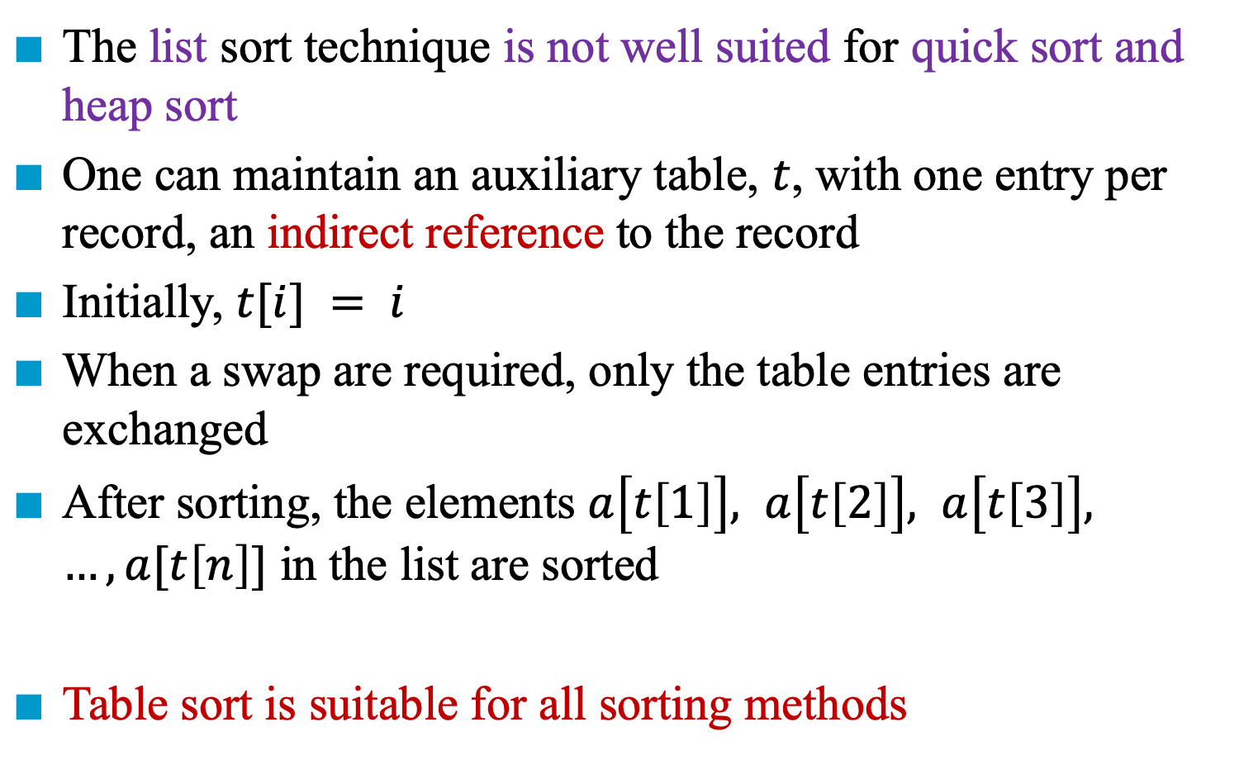
Table Sort
The list sort technique is not well suited for quick sort and heap sort
One can maintain an auxiliary table, $t$, with one entry per record, an indirect reference to the record
Initially, $t[i] = i$
When a swap are required, only the table entries are exchanged
After sorting, the elements $a\left[t\left[1\right]\right], a\left[t\left[2\right]\right], a\left[t\left[3\right]\right], …, a[t\left[n\right]]$ in the list are sorted
Table sort is suitable for all sorting methods

Slide 130
Permutation Cycle
After sorting
Permutation [3, 2, 8, 5, 7, 1, 4, 6]
Every permutation is made up of disjoint permutation cycles:
(1, 3, 8, 6) is a nontrivial cycle
R1 now is in position 3, R3 in position 8, R8 is in position 6, R6 is position.
(4, 5, 7) is another nontrivial cycle
(2) is a trivial cycle
 | R1 | R2 | R3 | R4 | R5 | R6 | R7 | R8
key | 35 | 14 | 12 | 42 | 26 | 50 | 31 | 18
t | 3 | 2 | 8 | 5 | 7 | 1 | 4 | 6

Slide 131
Example
Initial configuration
 | R1 | R2 | R3 | R4 | R5 | R6 | R7 | R8
key | 35 | 14 | 12 | 42 | 26 | 50 | 31 | 18
t | 3 | 2 | 8 | 5 | 7 | 1 | 4 | 6
After rearrange of first cycle
 | R1 | R2 | R3 | R4 | R5 | R6 | R7 | R8
key | 12 | 14 | 18 | 42 | 26 | 35 | 31 | 50
t | 1 | 2 | 3 | 5 | 7 | 6 | 4 | 8

Slide 132
Example
After rearrange of first cycle
 | R1 | R2 | R3 | R4 | R5 | R6 | R7 | R8
key | 12 | 14 | 18 | 42 | 26 | 35 | 31 | 50
t | 1 | 2 | 3 | 5 | 7 | 6 | 4 | 8
After rearrange of first cycle
 | R1 | R2 | R3 | R4 | R5 | R6 | R7 | R8
key | 12 | 14 | 18 | 26 | 31 | 35 | 42 | 50
t | 1 | 2 | 3 | 4 | 5 | 6 | 7 | 8

Slide 133
Algorithm for Table Sort
void tableSort(element a[], int n,
int t[])
{
int i, current, next;
element temp;
for (i=0; i<n-1; i++)
if (t[i]!=i) {
temp = a[i];
current= i;
// Non-trivial cycle

Slide 134
current = i = 4
current = 5
current = 6
do {
next = t[current];
a[current] = a[next];
t[current] = current;
current = next;
} while (t[current]!=i);
a[current] = temp;
t[current] = current;
}
}

Slide 136
External Sorting
Some lists are too large to fit in the memory of a computer
Some records are stored in the disk
Merge sort
Segments of the input list are sorted (using an internal method)
Sorted segments (called runs) are written onto external storage
Runs are merged until only run is left

Slide 137
Example
Consider a computer which is capable of sorting 750 records is used to sort 4500 records (i.e., 6x)
Six runs are generated with each run sorting 750 records by internal sort
Disk has a block length of 250 records
Allocate three 250-record blocks of internal memory for performing merging runs
Two for input run 2 runs and the last one is for output
Three factors contributing to the read/write time of disk:
Seek time
Latency time
Transmission time
Run 1
Run 2
Run 6
…
1-750
751-1500
3751-4500

Slide 138
File: 4500 records, a[1], …, a[4500]
Internal memory: 750 records (3 blocks)
Block length: 250 records
Input disk vs. scratch pad (disk)
Run i
750 records
(1) sort three blocks at a time and write them out onto scratch pad
(2) three blocks: two input buffers & one output buffer
3000 Records
(1 + 2 + 2/3) * 18 * 2 (i.e., I/O)
4500 Records

Slide 140
Optimal Merging of Runs
When runs are of different sizes, it is more important to determine the run merge strategy
26
26
11
15
6
20
6
5
2
4
5
15
2
4

Slide 141
Optimal Merging of Runs
When runs are of different sizes, it is more important to determine the run merge strategy
26
26
11
15
6
20
6
5
2
4
5
15
Weighted external path length
= 2*2 + 4*2 + 5*2 + 15*2
= 52
2
4
Weighted external path length
= 2*3 + 4*3 + 5*2 + 15*1
= 43

Slide 142
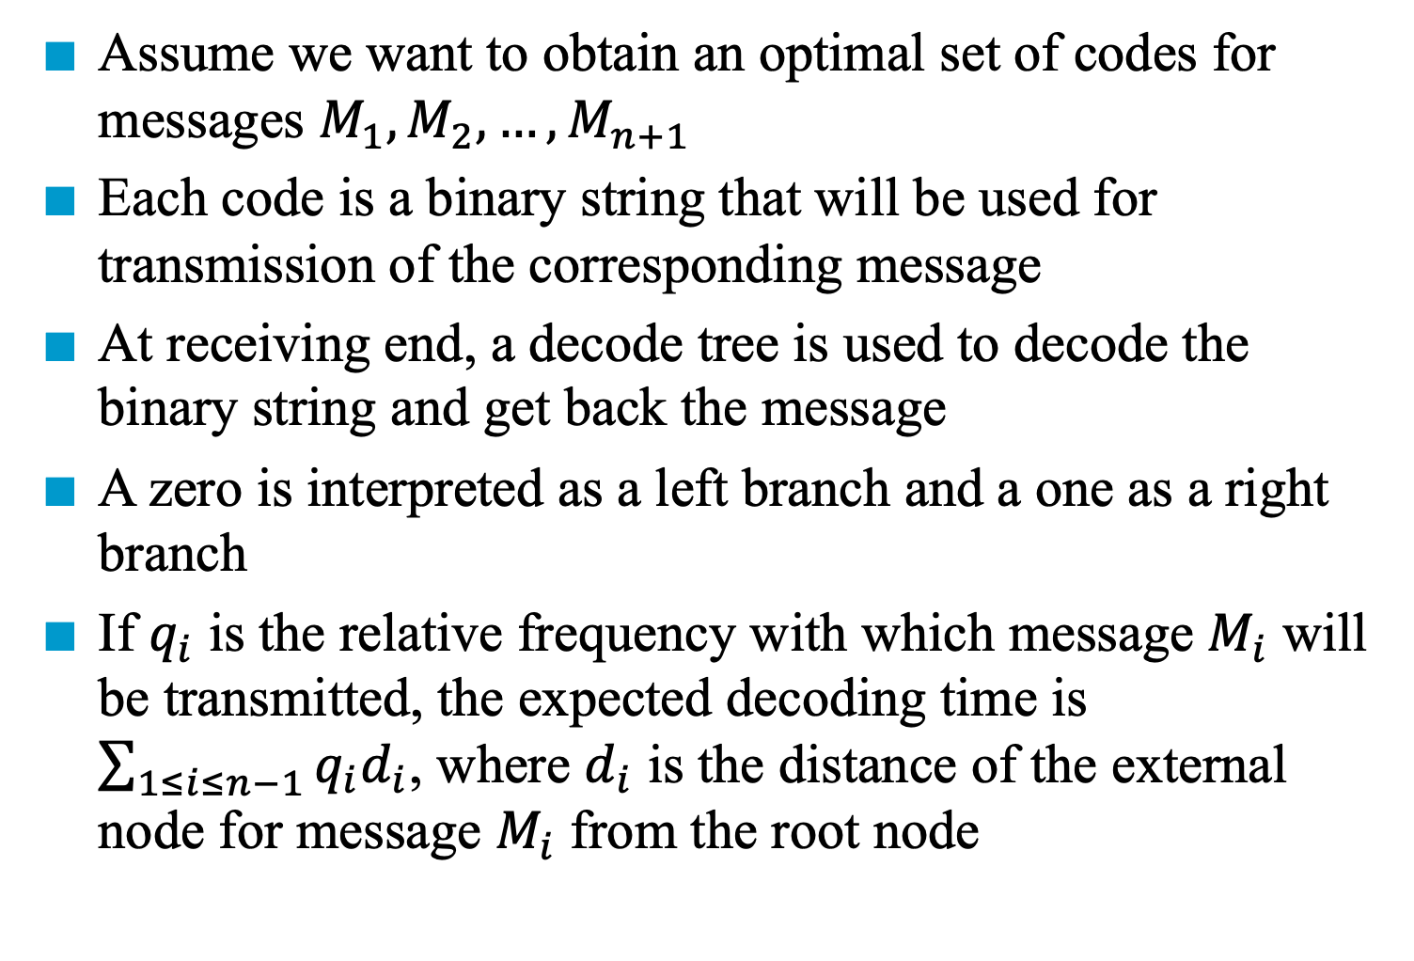
Huffman Code
Assume we want to obtain an optimal set of codes for messages $M_{1},M_{2},…,M_{n+1}$
Each code is a binary string that will be used for transmission of the corresponding message
At receiving end, a decode tree is used to decode the binary string and get back the message
A zero is interpreted as a left branch and a one as a right branch
If $q_{i}$ is the relative frequency with which message $M_{i}$ will be transmitted, the expected decoding time is $\sum_{1≤i≤n−1}{q_{i}d_{i}}$, where $d_{i}$ is the distance of the external node for message $M_{i}$ from the root node

Slide 143
Merging
Given two sorted lists (list[i], …, list[m]) (list[m+1], …, list[n]) generate a single sorted list (sorted[i], …, sorted[n])
O(n) space vs. O(1) space

Slide 144
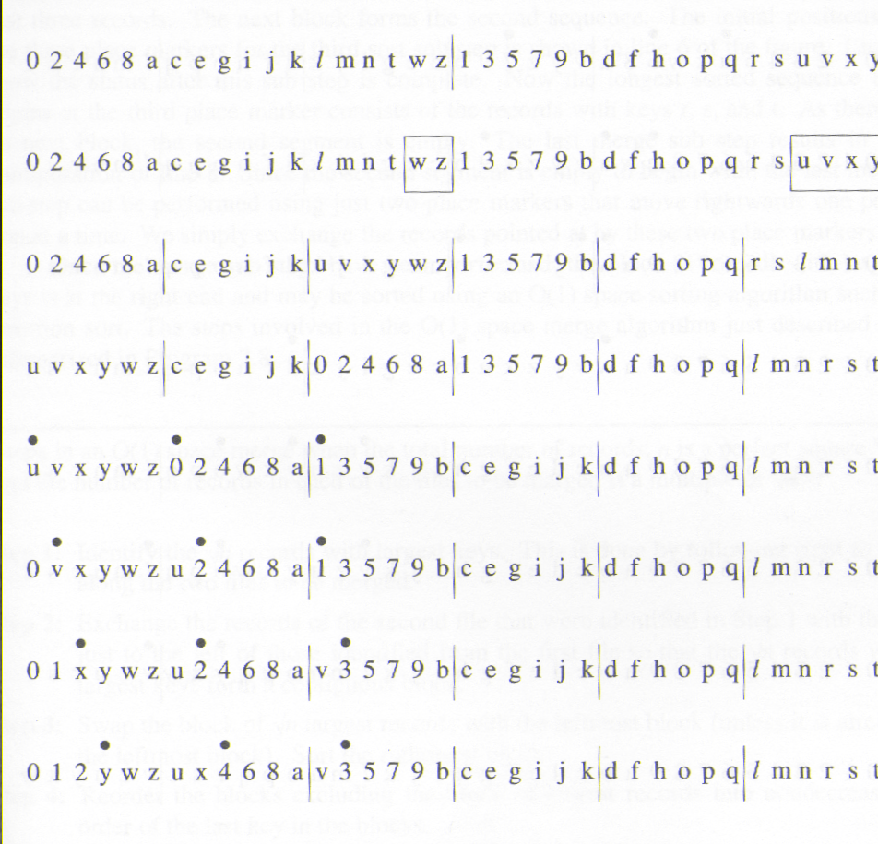
*Figure 7.5:First eight lines for O(1) space merge example (p337)
file 1 (sorted)
file 2 (sorted)
discover
keys
exchange
preprocessing
exchange
sort
Sort by the rightmost records of
-1 blocks
compare
exchange
compare
exchange
compare

Slide 145
•
•
•
0 1 2 y w z u x 4 6 8 a v 3 5 7 9 b c e g i j k d f h o p q l m n r s t
•
•
•
0 1 2 3 w z u x 4 6 8 a v y 5 7 9 b c e g i j k d f h o p q l m n r s t
•
•
•
0 1 2 3 4 z u x w 6 8 a v y 5 7 9 b c e g i j k d f h o p q l m n r s t
•
•
•
0 1 2 3 4 5 u x w 6 8 a v y z 7 9 b c e g i j k d f h o p q l m n r s t

Slide 146
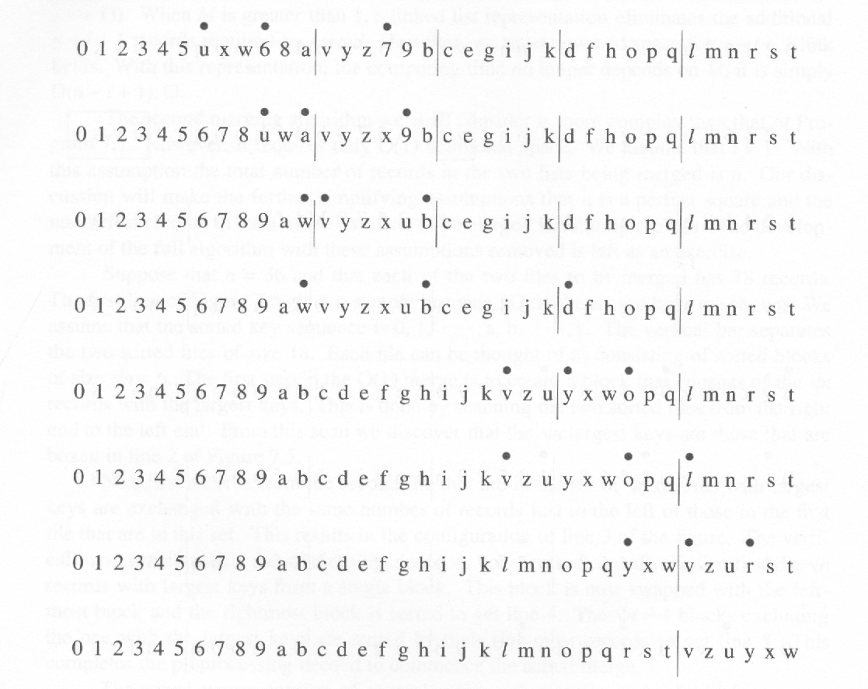
*Figure 7.6:Last eight lines for O(1) space merge example(p.338)
6, 7, 8 are merged
Segment one is merged (i.e., 0, 2, 4, 6, 8, a)
Change place marker (longest sorted sequence of records)
Segment one is merged (i.e., b, c, e, g, i, j, k)
Change place marker
Segment one is merged (i.e., o, p, q)
No other segment. Sort the largest keys.

Slide 147
*Program 7.8: O(1) space merge (p.339) Steps in an O(1) space merge when the total number of records, n is a perfect square */ and the number of records in each of the files to be merged is a multiple of √n */ Step1:Identify the √n records with largest key. This is done by following right to left along the two files to be merged. Step2:Exchange the records of the second file that were identified in Step1 with those just to the left of those identified from the first file so that the √n record with largest keys form a contiguous block. Step3:Swap the block of √n largest records with the leftmost block (unless it is already the leftmost block). Sort the rightmost block.

Slide 148
Step4:Reorder the blocks excluding the block of largest records into nondecreasing order of the last key in the blocks. Step5:Perform as many merge sub steps as needed to merge the √n-1 blocks other than the block with the largest keys. Step6:Sort the block with the largest keys.

Slide 149
Analysis for Quick Sort
Assume that each time a record is positioned, the list is divided into the rough same size of two parts
Position a list with n element needs O(n)
T(n) is the time taken to sort n elements T(n) <= cn + 2T(n/2) for some c <= cn + 2(cn/2 + 2T(n/4)) ... <=c n log n + nT(1) = O(n log n)

Slide 150
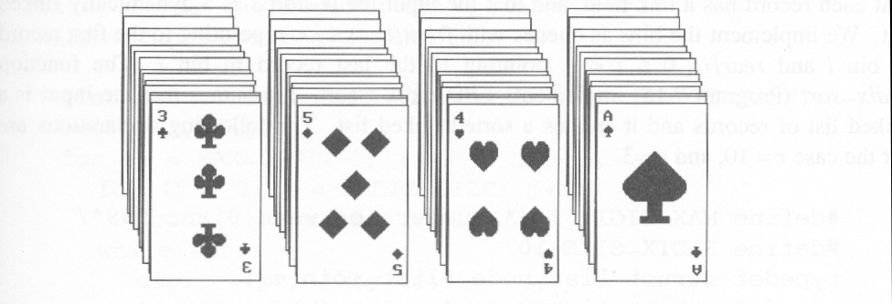
Figure 7.14: Arrangement of cards after first pass of an MSD sort(p.353)
Suits: ♣ < ♦ < ♥ < ♠
Face values: 2 < 3 < 4 < … < J < Q < K < A
(1) MSD sort first, e.g., bin sort, four bins ♣ ♦ ♥ ♠
LSD sort second, e.g., insertion sort
(2) LSD sort first, e.g., bin sort, 13 bins
2, 3, 4, …, 10, J, Q, K, A
MSD sort, e.g., bin sort four bins ♣ ♦ ♥ ♠

Slide 151
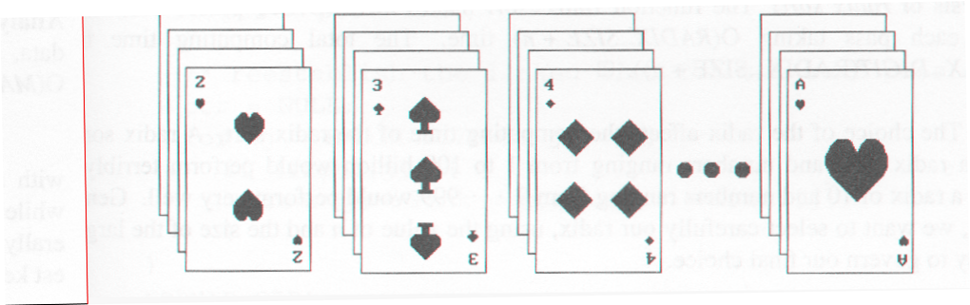
Figure 7.15: Arrangement of cards after first pass of LSD sort (p.353)

Slide 152
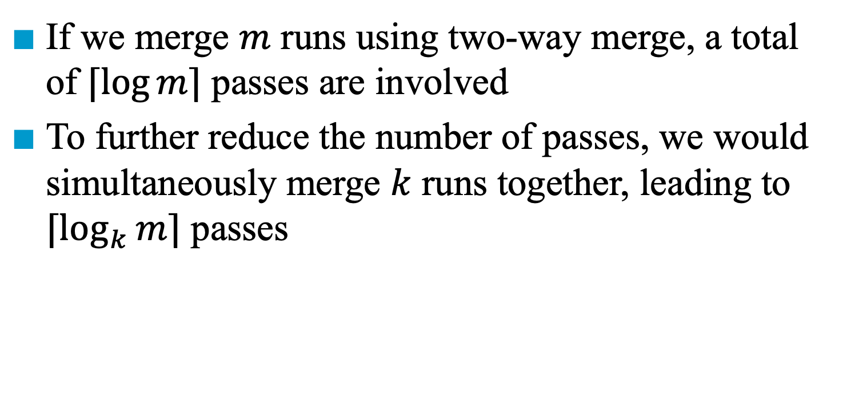
K-Way Merging
If we merge $m$ runs using two-way merge, a total of $⌈\log{m}⌉$ passes are involved
To further reduce the number of passes, we would simultaneously merge $k$ runs together, leading to $⌈\log_{k}{m}⌉$ passes
1 2 3 4
1 2 3 4
1 2 3 4
1 2 3 4
A 4-way merge on 16 runs
2 passes (4-way) vs. 4 passes (2-way)

Slide 153
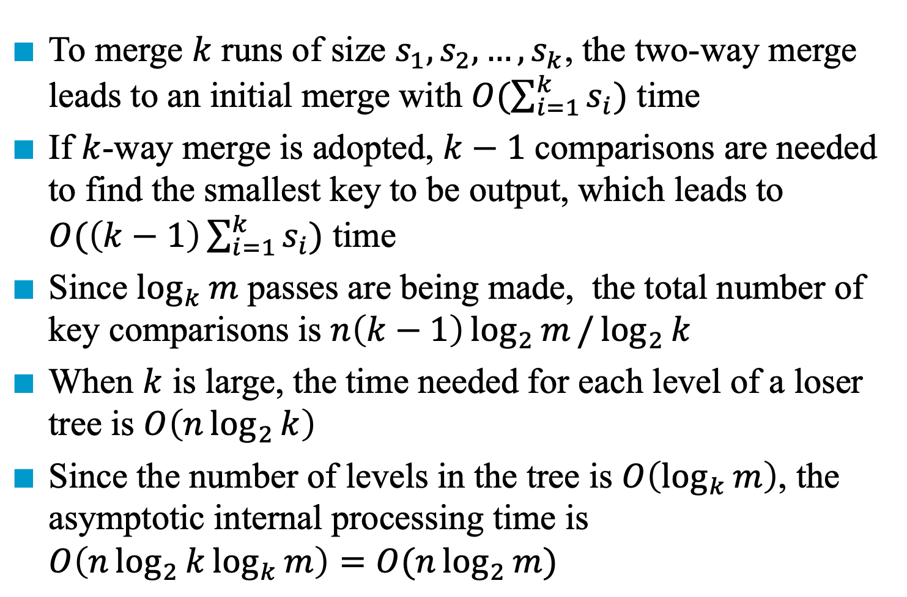
Analysis
To merge $k$ runs of size $s_{1}, s_{2},…,s_{k}$, the two-way merge leads to an initial merge with $O(\sum_{i=1}^{k}{s_{i}})$ time
If $k$-way merge is adopted, $k−1$ comparisons are needed to find the smallest key to be output, which leads to $O(\left(k−1\right)\sum_{i=1}^{k}{s_{i}})$ time
Since $\log_{k}{m}$ passes are being made, the total number of key comparisons is $n\left(k−1\right)\log_{2}{m}/\log_{2}{k}$
When $k$ is large, the time needed for each level of a loser tree is $O\left(n\log_{2}{k}\right)$
Since the number of levels in the tree is $O\left(\log_{k}{m}\right)$, the asymptotic internal processing time is $O\left(n\log_{2}{k}\log_{k}{m}\right)=O(n\log_{2}{m})$

Slide 154
(2)
(1)
i=0
start=1
原值已放在start中
值不變
i=1
start=5
i=2
start=7
原值已放在start中
值不變

Slide 155
i=3
start=9
值不變
原值已放在start中
i=4
start=0
想把第0個元素放在第5個位置？
想把第3個元素放在第5個位置？
想把第7個元素放在第5個位置？
i=5
start=8

Slide 156
Table Sort
Before
sort
1 • 2 • 3 • 4 • 5 •
Auxiliary
table
T
Data are not moved.
(0,1,2,3,4)
R₀
50
R₁
9
R₂
11
R₃
8
R₄
3
Key
A permutation
linked list sort
(4,3,1,2,0)
Auxiliary
table
T
After
sort
5 • 4 • 2 • 3 • 1 •
第1名在第5個位置，第2名在第4個位置，…，第5名在第1個位置
(0,1,2,3,4)

Slide 157
Every permutation is made of disjoint cycles.
Example
R0 R1 R2 R3 R4 R5 R6 R7
35 14 12 42 26 50 31 18
2 1 7 4 6 0 3 5
key
table
two nontrivial cycles
trivial cycle
R0 R2 R7 R5 R0
2 7 5 0
R1 R1
1
R3 R4 R6 R3
4 6 3 4

Slide 158
(1) R0 R2 R7 R5 R0
0 2 7 5
12 18 50 35
35 0
(2) i=1,2 t[i]=i
(3) R3 R4 R6 R3
3 4 6
26 31 42
42 3

Slide 159
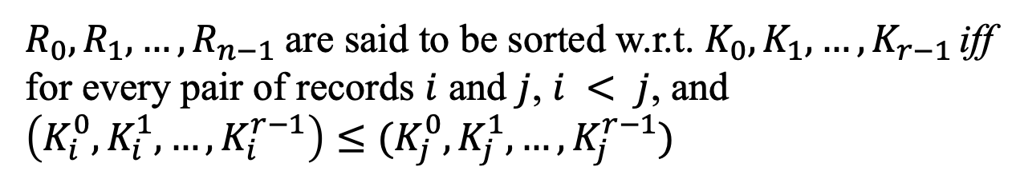
Radix
Sort by keys
K⁰, K¹, …, K^{r-1}
Most significant key
Least significant key
$R_{0}, R_{1}, …, R_{n−1}$are said to be sorted w.r.t. $K_{0}, K_{1}, …, K_{r−1}$ iff for every pair of records $i$ and $j$, $i < j$, and $\left(K_{i}^{0}, K_{i}^{1},…,K_{i}^{r−1}\right)≤(K_{j}^{0}, K_{j}^{1},…,K_{j}^{r−1})$
Most significant digit first: sort on K⁰, then K¹, ...
Least significant digit first: sort on K^{r-1}, then K^{r-2}, ...

Slide 160
Radix
0 ≤ K ≤ 999
(K⁰, K¹, K²)
MSD
LSD
0-9
0-9
0-9
radix 10 sort
radix 2 sort

Slide 161
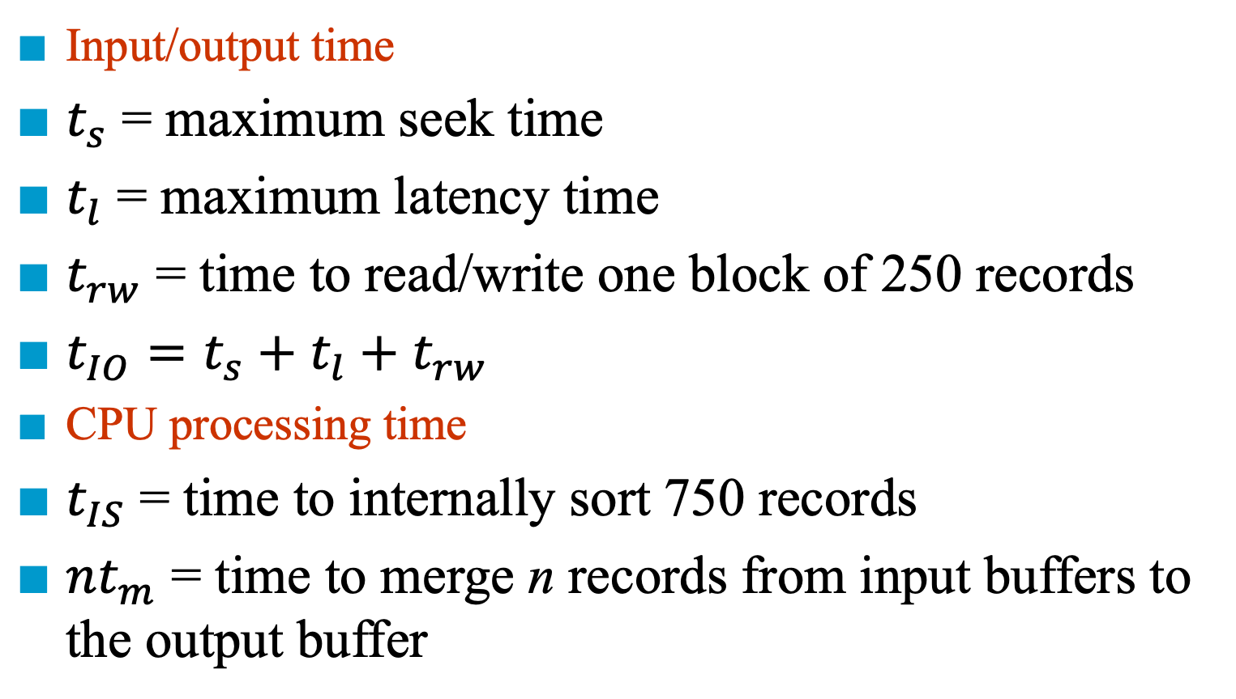
Time Complexity of External Sort
Input/output time
$t_{s}$ = maximum seek time
$t_{l}$ = maximum latency time
$t_{rw}$ = time to read/write one block of 250 records
$t_{IO}=t_{s}+t_{l}+t_{rw}$
CPU processing time
$t_{IS}$ = time to internally sort 750 records
$nt_{m}$ = time to merge n records from input buffers to the output buffer

Slide 162
Time Complexity of External Sort (Continued)
132
Critical factor: number of passes over the data
Runs: m
Pass: ⎡log₂m⎤

Slide 163
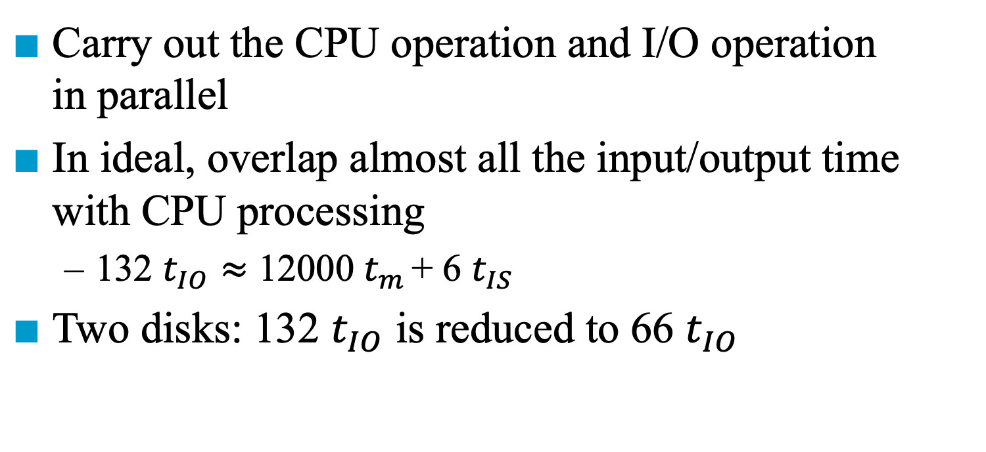
Consider Parallelism
Carry out the CPU operation and I/O operation in parallel
In ideal, overlap almost all the input/output time with CPU processing
132 $t_{IO}≈$ 12000 $t_{m}$ + 6 $t_{IS}$
Two disks: 132 $t_{IO}$ is reduced to 66 $t_{IO}$

